Slide 1
Improving the vertical position reconstruction
Analysis Meeting 07/12/23

Slide 2
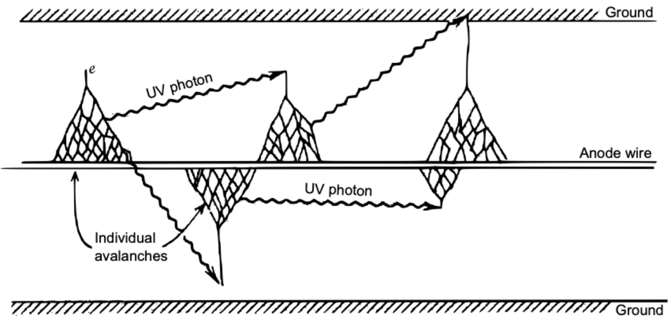
Vertical Position calculation
Tracker cell Plasma:
Initial ionization triggers avalanche
UV photons emitted
UV triggers avalanches up and down the cell
We describe this as a plasma moving through the cell
Vertical Position Calculation Analysis meeting 7/12/23

Slide 3
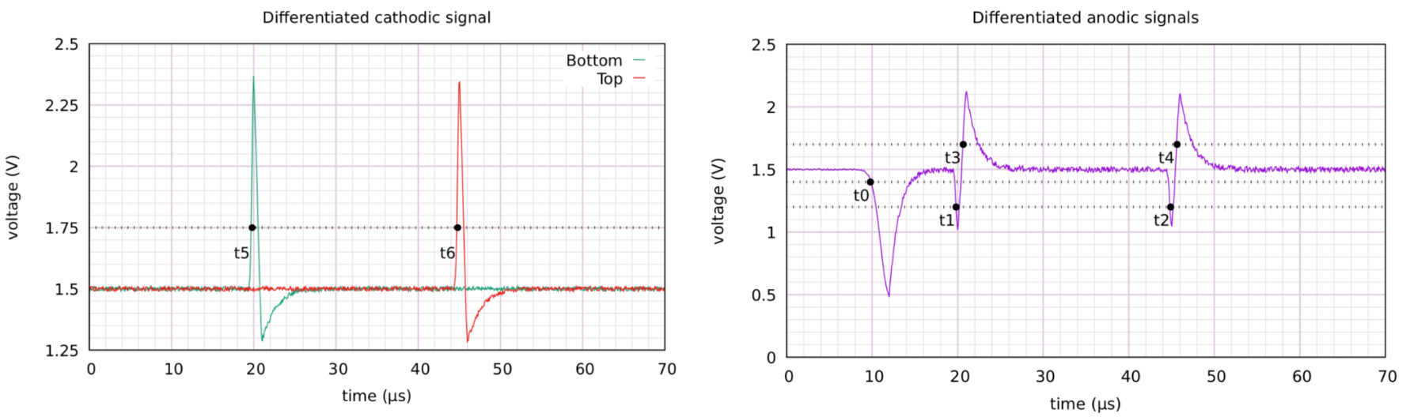
Vertical Position calculation
Tracker cell Plasma:
Initial ionization triggers avalanche
UV photons emitted
UV triggers avalanches up and down the cell
We describe this as a plasma moving through the cell
Timestamp values:
T0 is considered when the plasma starts
Other timestamps indicated when plasma reached end of cell
Vertical Position Calculation Analysis meeting 7/12/23

Slide 4
Vertical Position calculation
Tracker cell Plasma:
Initial ionization triggers avalanche
UV photons emitted
UV triggers avalanches up and down the cell
We describe this as a plasma moving through the cell
Plasma reaches near end
Plasma reaches far end
Timestamp values:
T0 is considered when the plasma starts
Other timestamps indicated when plasma reached end of cell
Anode quenched
Initial ionization
Vertical Position Calculation Analysis meeting 7/12/23

Slide 5
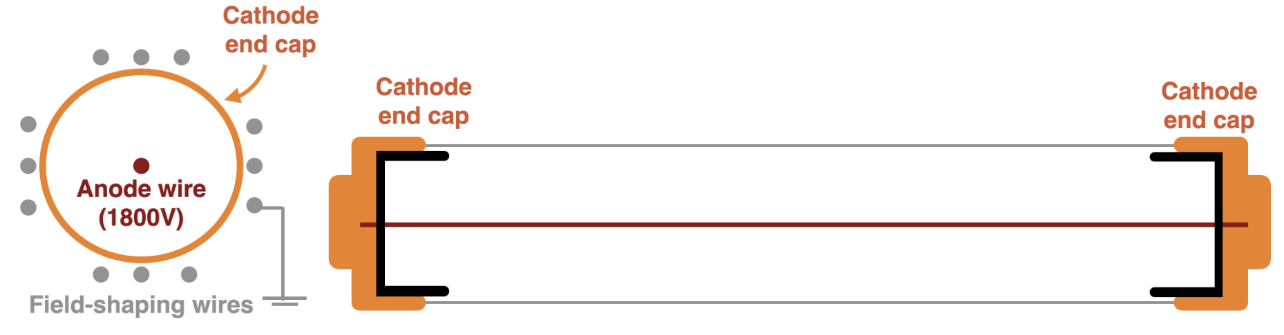
Vertical Position calculation
Tracker cell Plasma:
Initial ionization triggers avalanche
UV photons emitted
UV triggers avalanches up and down the cell
We describe this as a plasma moving through the cell
Plasma reaches near end
Plasma reaches far end
Timestamp values:
T0 is considered when the plasma starts
Other timestamps indicated when plasma reached end of cell
Anode quenched
Initial ionization
Vertical Position Calculation Analysis meeting 7/12/23

Slide 6
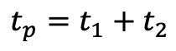
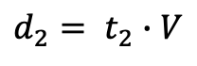
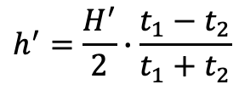
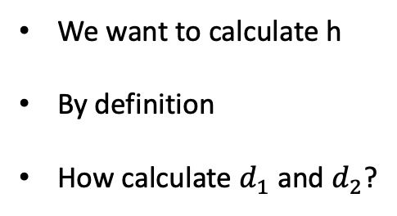
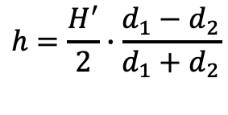
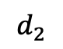
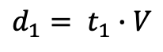
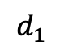
Vertical Position calculation
L
h
We want to calculate h
By definition
How calculate $d_{1}$ and $d_{2}$?
$$h=\frac{H^{′}}{2}∙\frac{d_{1}−d_{2}}{d_{1}+d_{2}}$$
$$d_{1}$$
$$d_{2}$$
Assume plasma propagates at constant speed:
$$d_{1}= t_{1}∙V$$
$$h^{′}=\frac{H^{′}}{2}∙\frac{t_{1}−t_{2}}{t_{1}+t_{2}}$$
$$d_{2}= t_{2}∙V$$
This is how everyone has been calculating vertical position so far
Define plasma propagation time:
$$t_{p}=t_{1}+t_{2}$$
But is the plasma speed really constant???
Vertical Position Calculation Analysis meeting 7/12/23

Slide 7
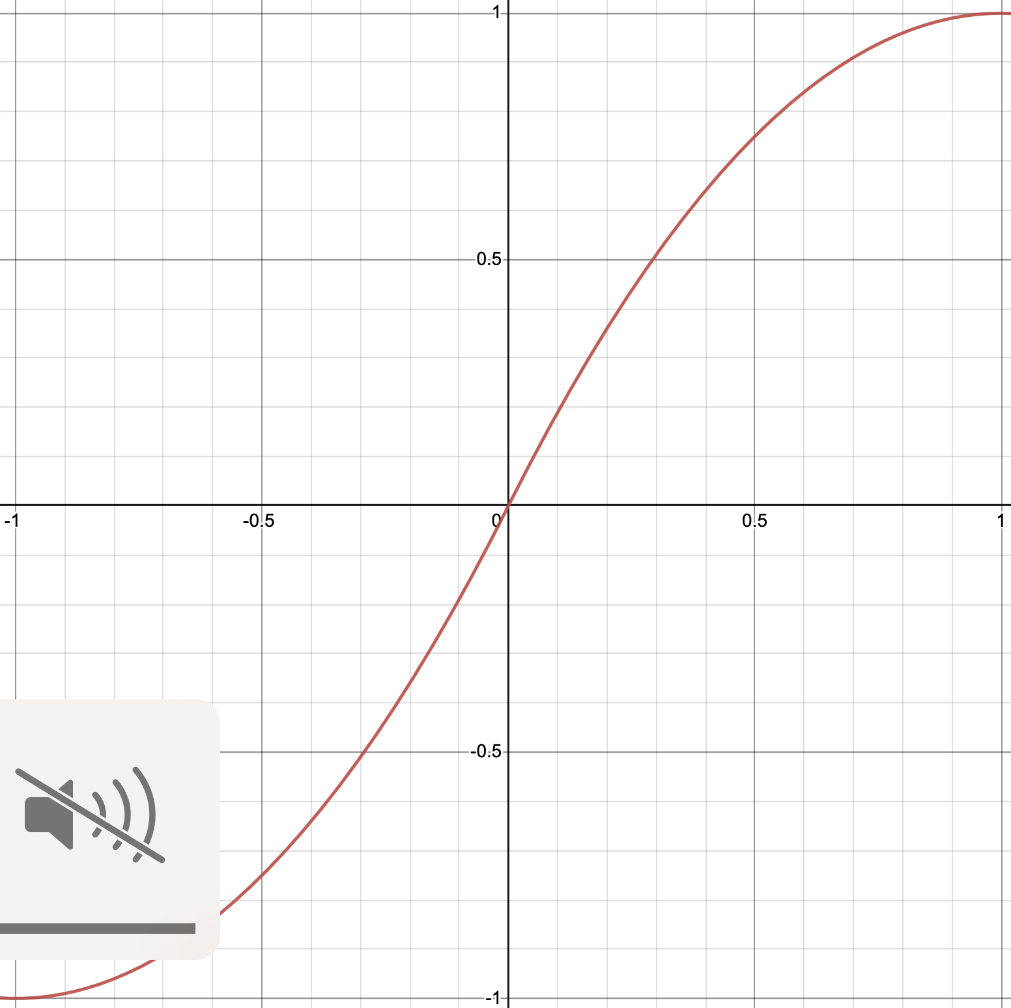
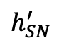
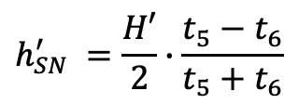
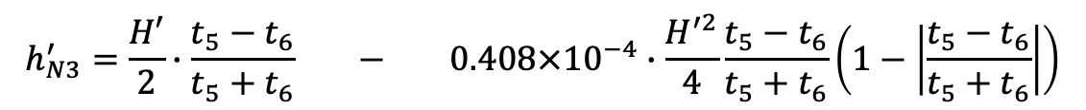
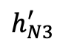
NEMO-3 Correction
L
Calculation used for height calc in NEMO-3
Plot below shows mapping to our current height calc
h
$$h_{SN}^{′} =\frac{H′}{2}∙\frac{t_{5}−t_{6}}{t_{5}+t_{6}}$$
$$d_{1}$$
$$d_{2}$$
(Linear height calc)
$$h_{N3}^{′}=\frac{H′}{2}∙\frac{t_{5}−t_{6}}{t_{5}+t_{6}} − 0.408×{10}^{−4}∙\frac{H^{′2}}{4}\frac{t_{5}−t_{6}}{t_{5}+t_{6}}\left(1−\left|\frac{t_{5}−t_{6}}{t_{5}+t_{6}}\right|\right)$$
$$h_{N3}^{′}$$
First order term – assumes constant plasma velocity
2nd order correction - accounts for decreasing plasma speed
NEMO-3 also used modified length of tracker cell in calculation**
$$h_{SN}^{′}$$
Vertical Position Calculation Analysis meeting 7/12/23

Slide 8
Overview
Overview of what has been seen
Nemo-3 corrected for deceleration of the plasma over time
Vertical Position Calculation Analysis meeting 7/12/23

Slide 9
Overview of what has been seen
Nemo-3 corrected for deceleration of the plasma over time
This effect can also be seen in SuperNEMO data
Effect 1
Red- slow moving
Green – fast moving
Vertical Position Calculation Analysis meeting 7/12/23

Slide 10
Overview
Overview of what has been seen
Nemo-3 corrected for deceleration of the plasma over time
This effect can also be seen in SuperNEMO data
A further dependance on drift radius can be seen
Effect 1
Red- slow moving
Green – fast moving
Effect 2
Top-down view of plasma cell
Vertical Position Calculation Analysis meeting 7/12/23

Slide 11
Overview
Overview of what has been seen
Nemo-3 corrected for deceleration of the plasma over time
This effect can also be seen in SuperNEMO data
A further dependance on drift radius can be seen
In reality these appear to be the same effect of non-trivial 3D movement of plasma+ion drift in cell
Effect 1
Red- slow moving
Green – fast moving
Effect 2
Top-down view of plasma cell
Vertical Position Calculation Analysis meeting 7/12/23

Slide 12
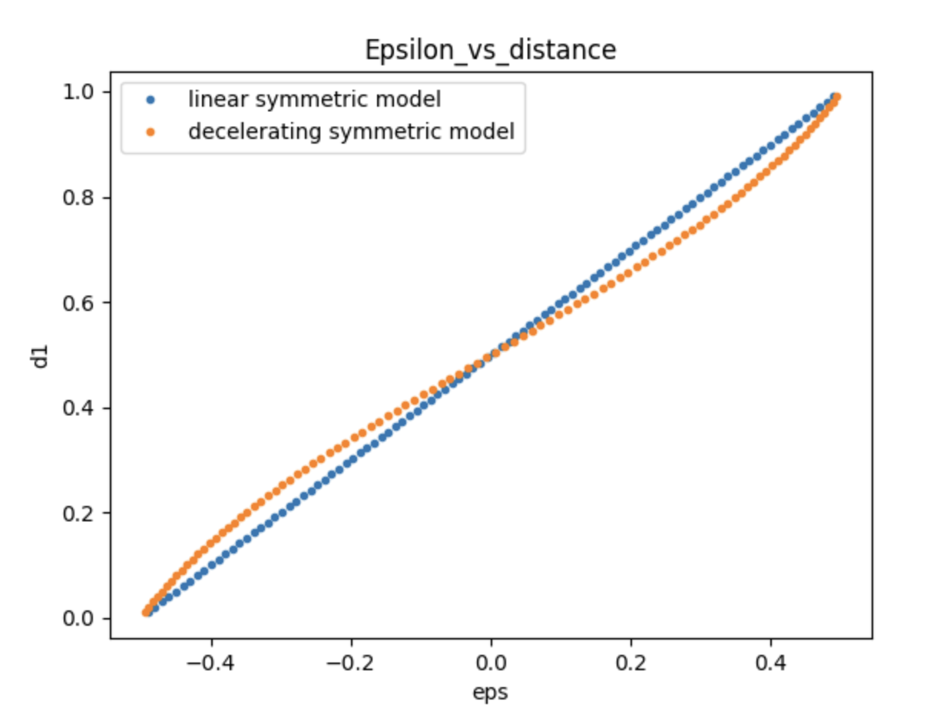
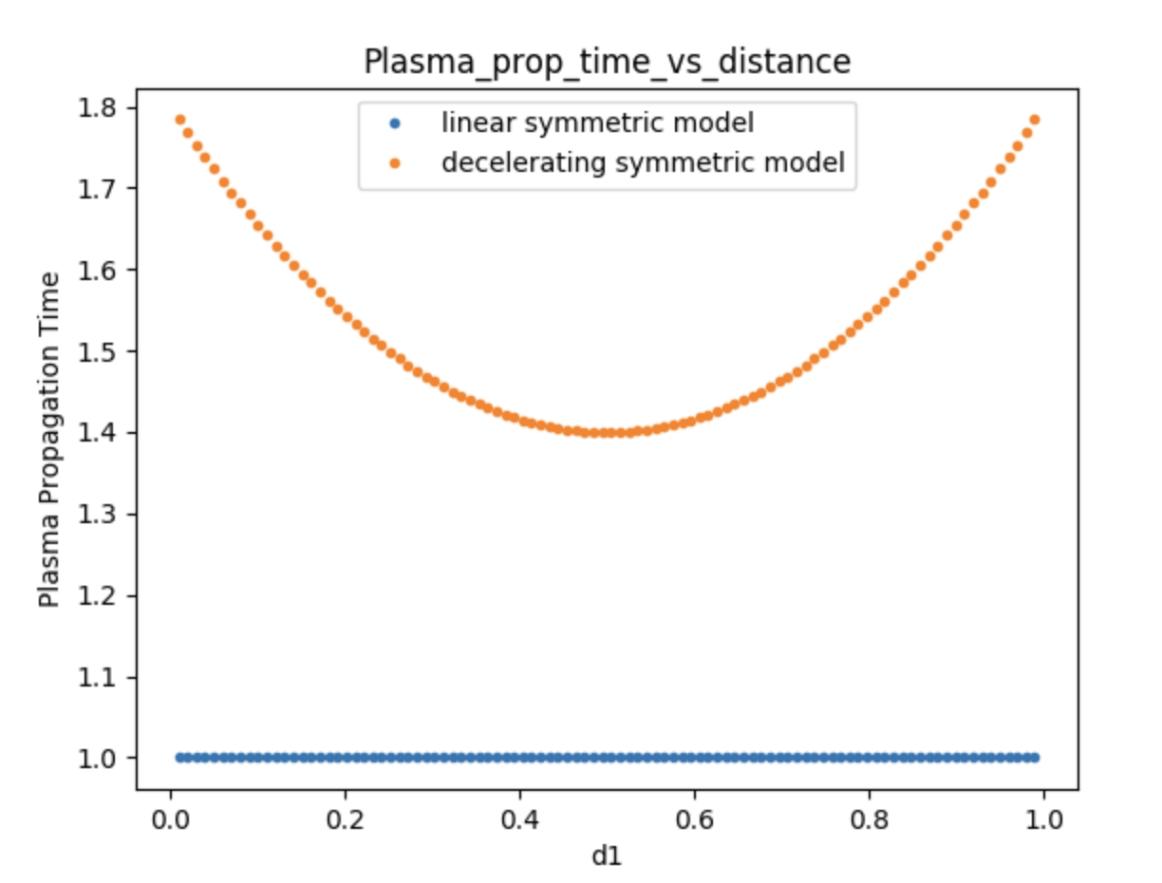
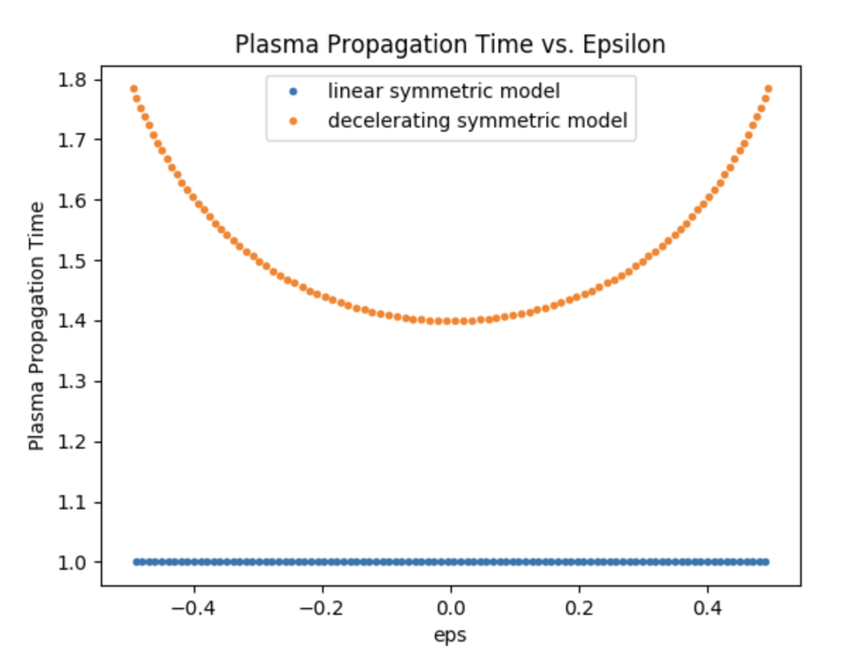
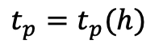
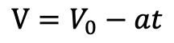
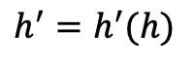

Model slow deceleration
h
Assume plasma velocity decreases over run
$$V=V_{0}−at$$
Express h’ and $t_{p}$ as functions of the true height h
$$h^{′}=h^{′}(h)$$
$$t_{p}=t_{p}(h)$$
h
0.1
0.3
0.5
0.7
0.9
h
0.1
0.3
0.5
0.7
0.9
h’
h’
h’
h’
h’ has mapping to true distance measurement
Propagation time against true distance in these models
Measured quantities
Vertical Position Calculation Analysis meeting 7/12/23

Slide 13
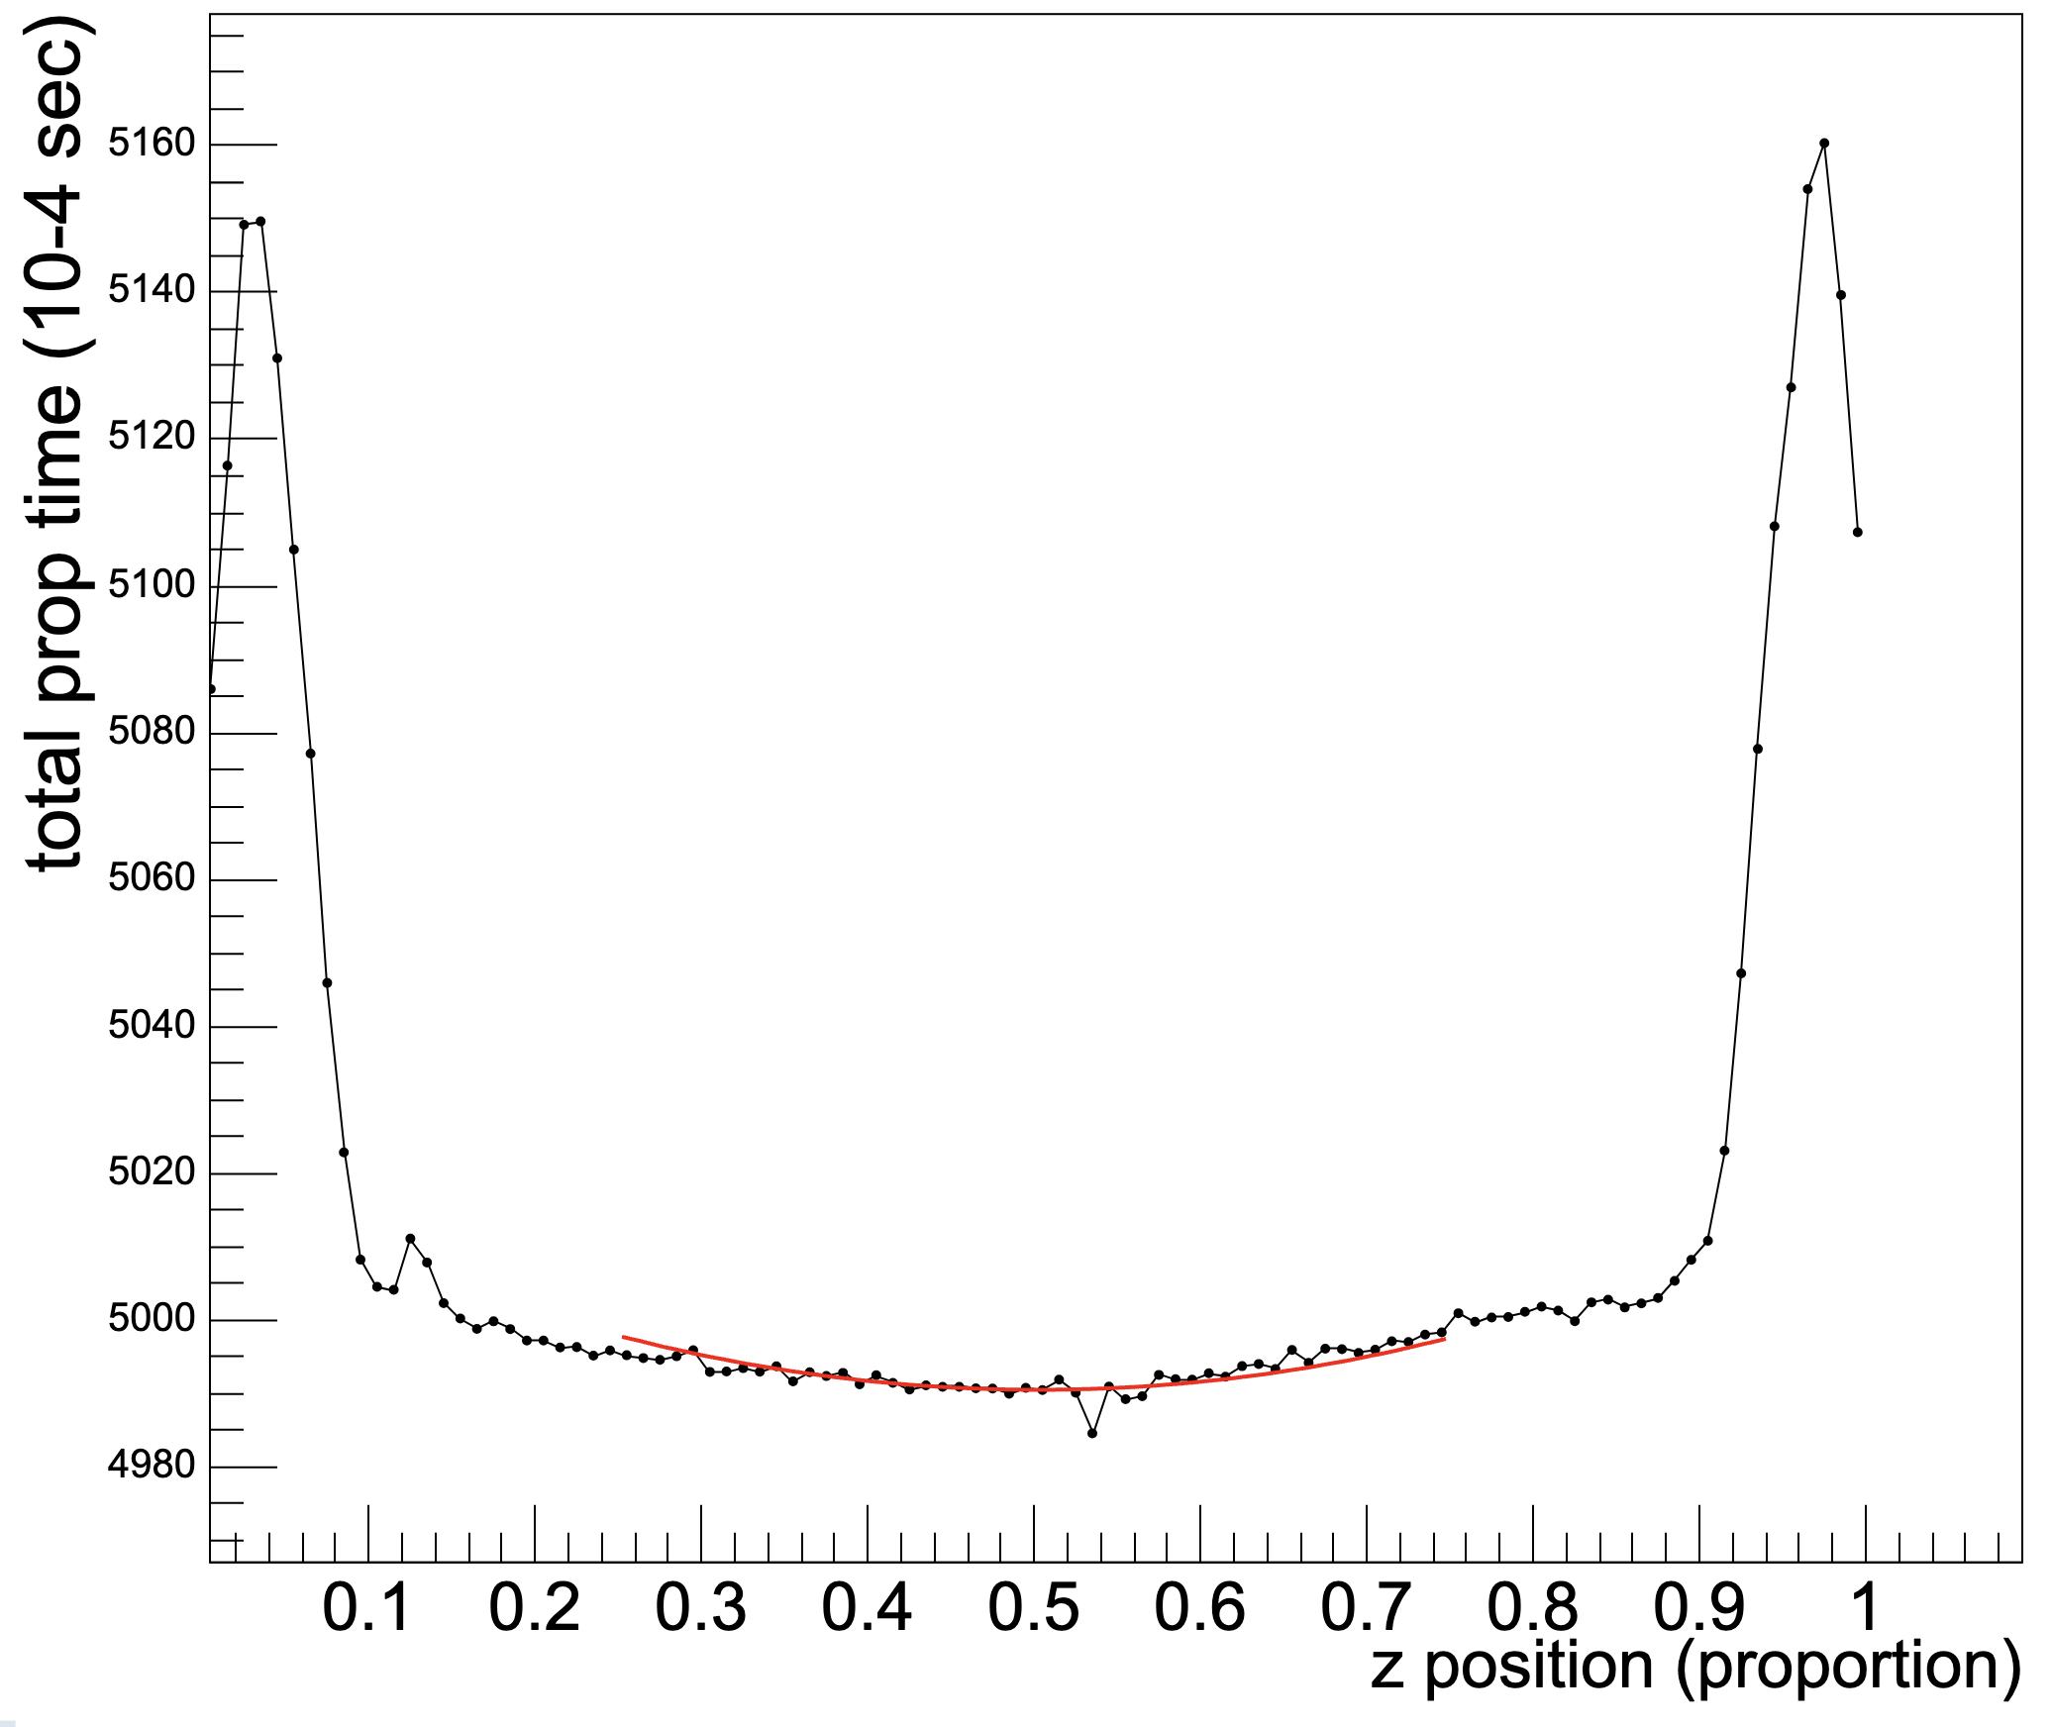
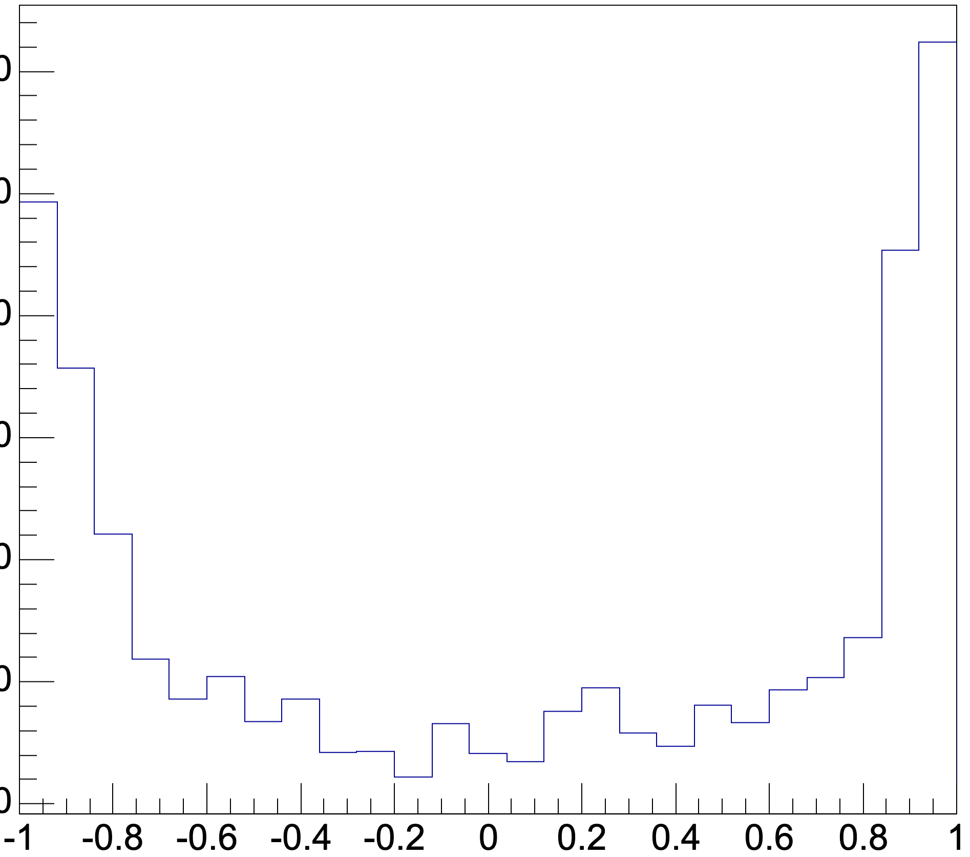
Slow deceleration in data
h’
From this we can extract acceleration parameters/metrics to describe the plasma
Note I have cut off edge region of the cell
Vertical Position Calculation Analysis meeting 7/12/23

Slide 14
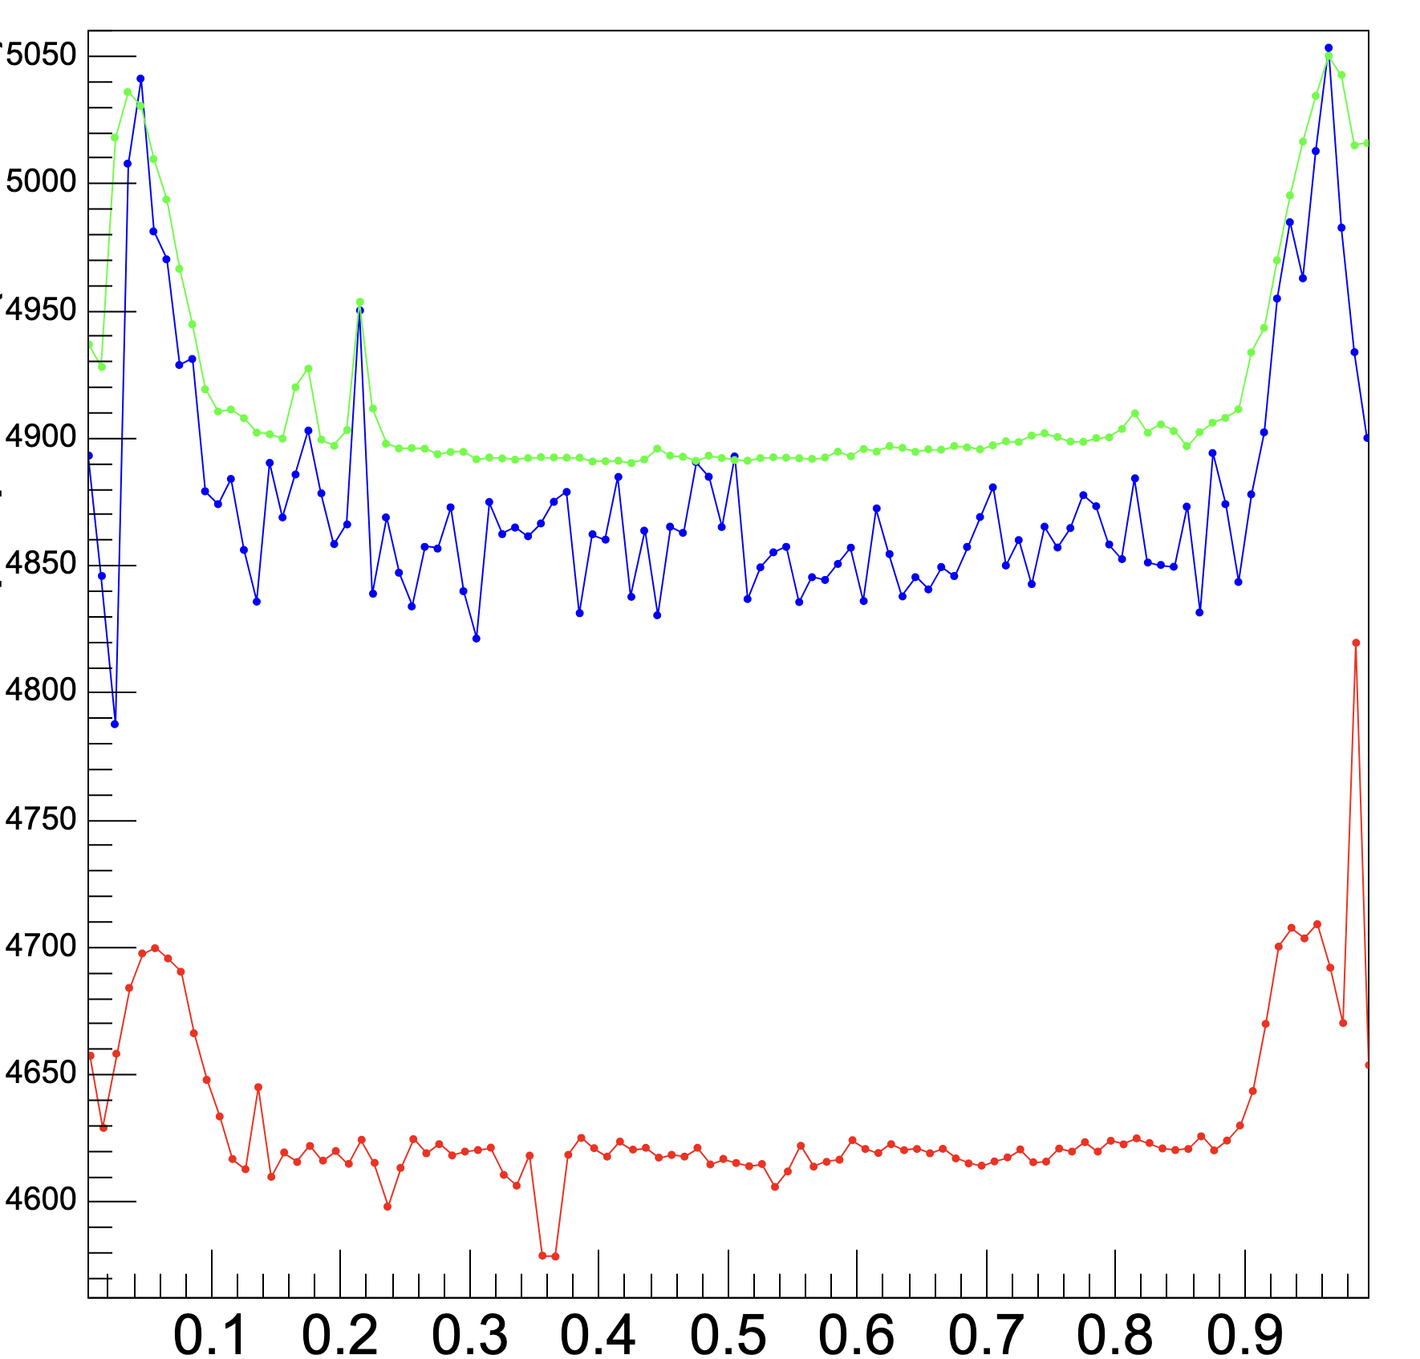
Selection cuts
Outer cell
Inner cell
Near bad cell
Remove/separate effects of cells with different plasma speeds
- Edge cells
- Dead cells
- Cells recently active
- Separate by crate
Propagation time (12.5ns)
Extract deceleration parameters from clean distribution
Use to calibrate each cells reconstruction
h’
Vertical Position Calculation Analysis meeting 7/12/23

Slide 15
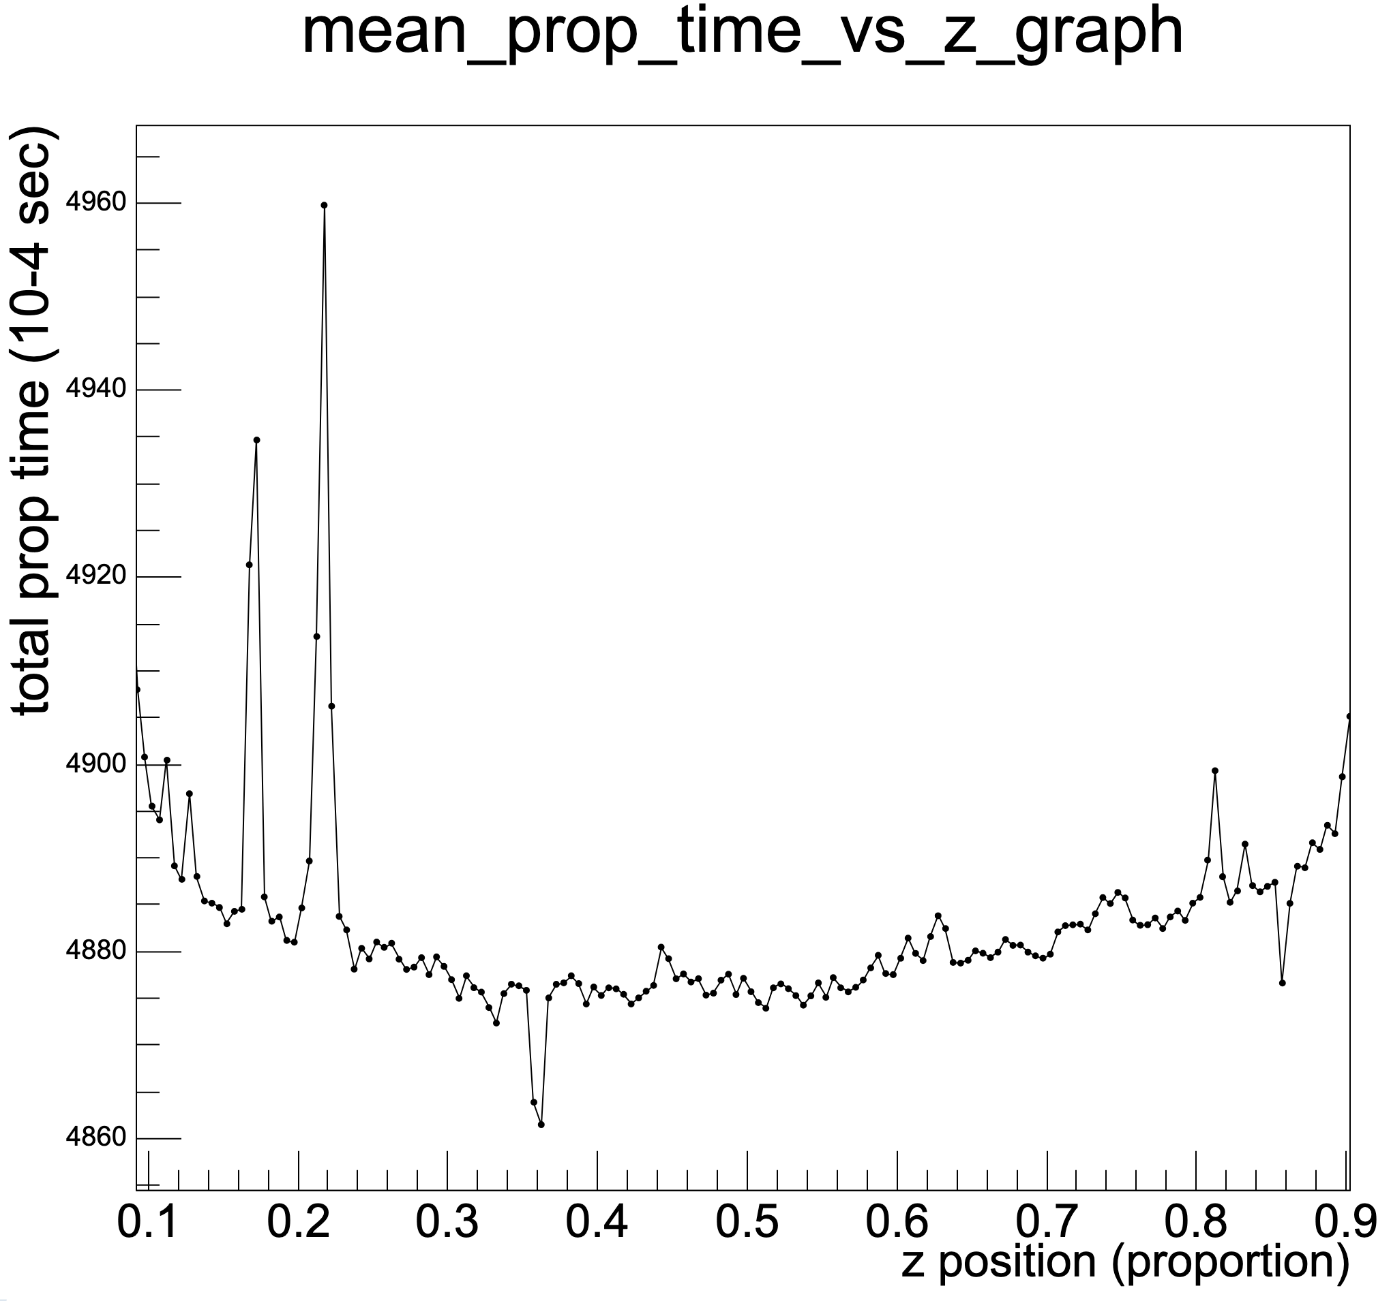
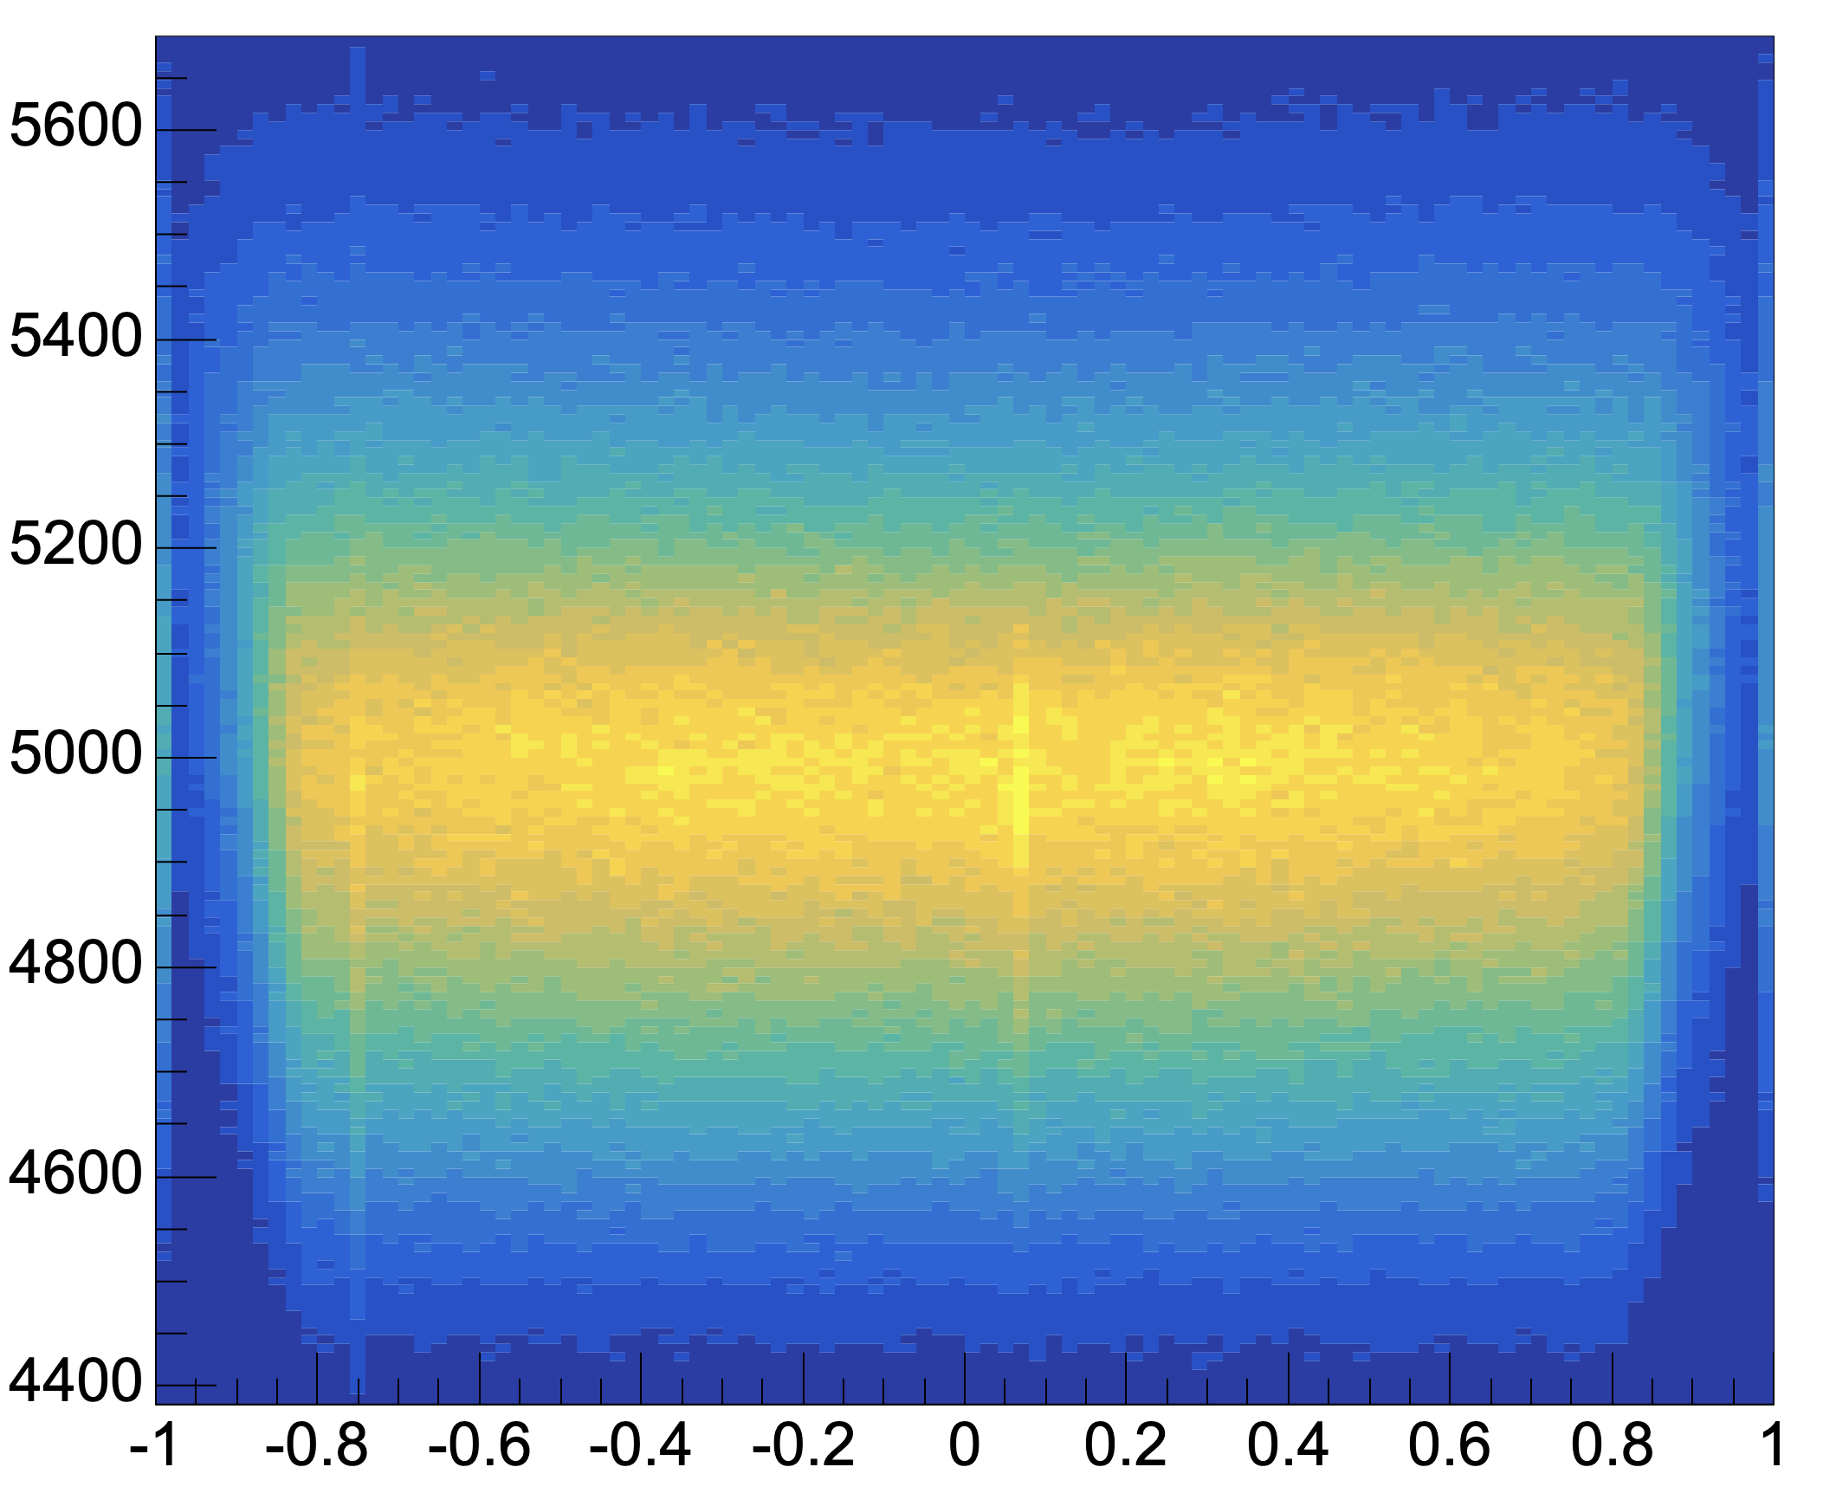
Understanding the Full distribution
Average propagation time vs z approximation
Heat map of propagation time against z approximation for each event
Extracting metric a/u^2 from this distribution for each cell
Can be used to correct for vertical position
This work still in progress
Vertical Position Calculation Analysis meeting 7/12/23

Slide 16
Drift Time effect on Vertical Position Calculation
Vertical movement of plasma ‘begins’
First ionization in tracker cell
Time
Calo Hit
Anode Signal
Cathode 1
Cathode 2
Vertical Position Calculation Analysis meeting 7/12/23

Slide 17
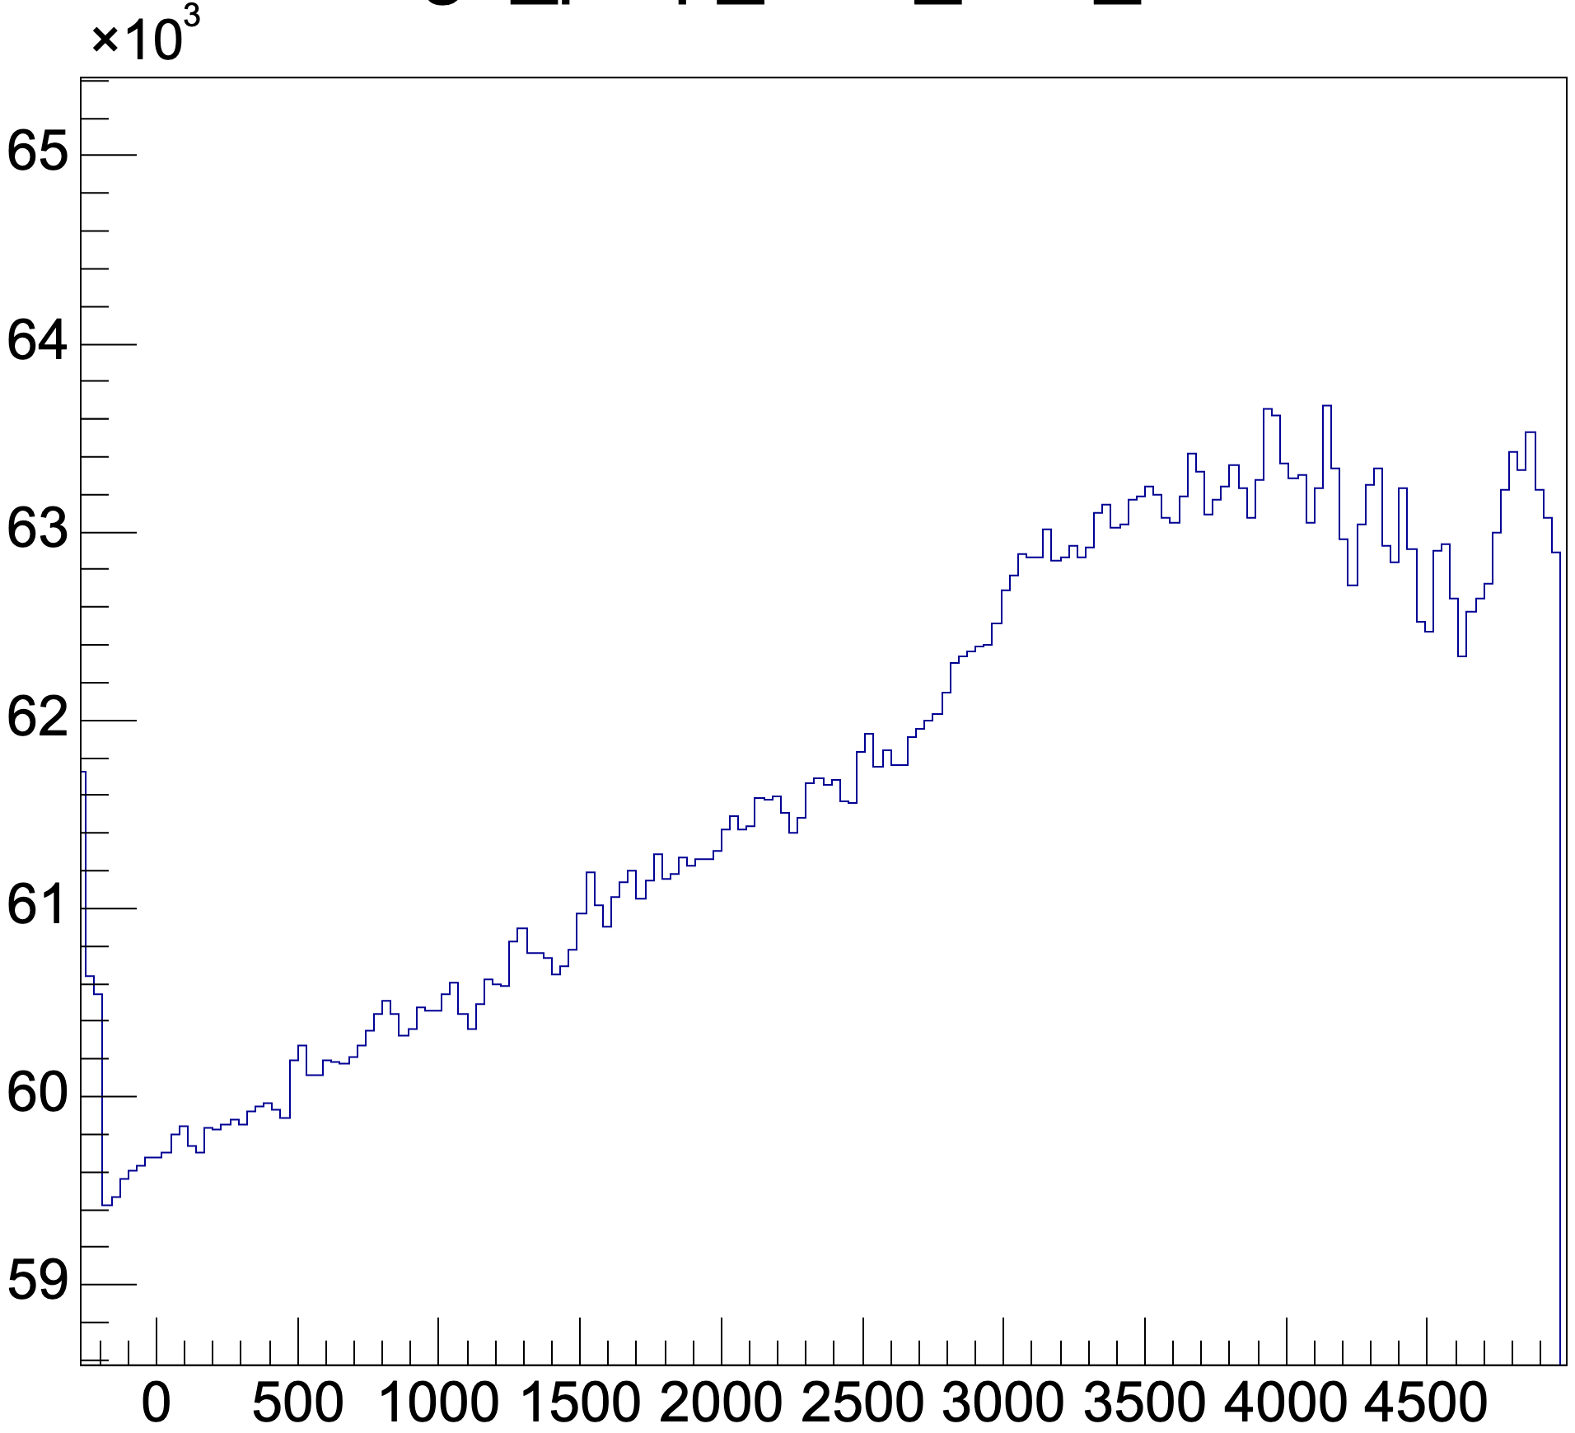
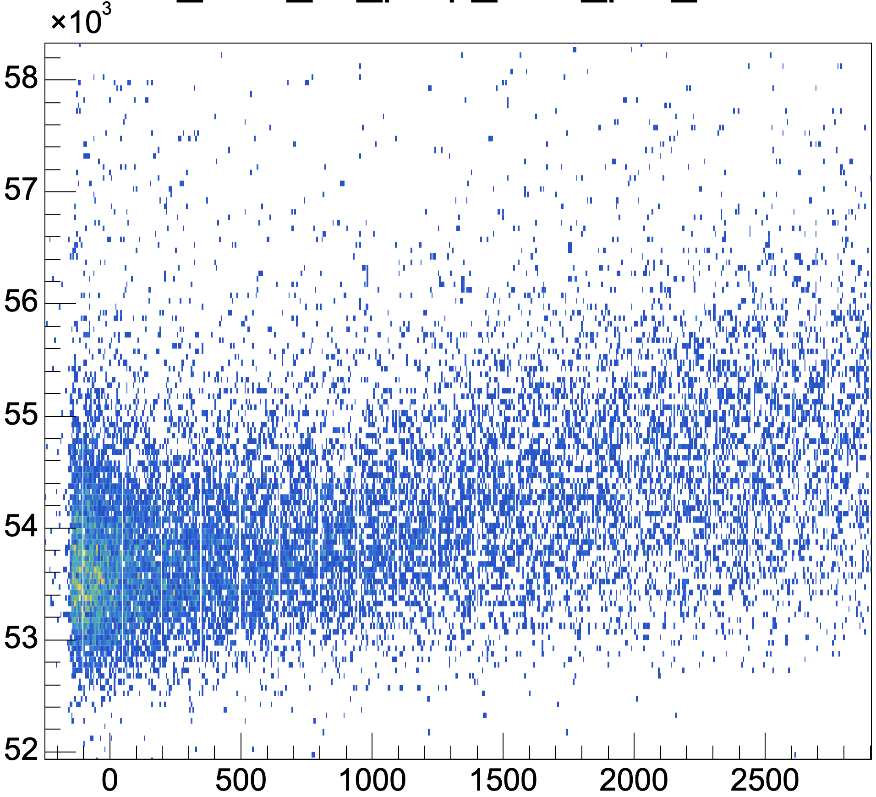
Drift Time effect on Vertical Position Calculation
Prop time (ns)
Prop time (ns)
Drift time (ns)
Drift time (ns)
Typical change in prop time with drift time
Vertical Position Calculation Analysis meeting 7/12/23

Slide 18
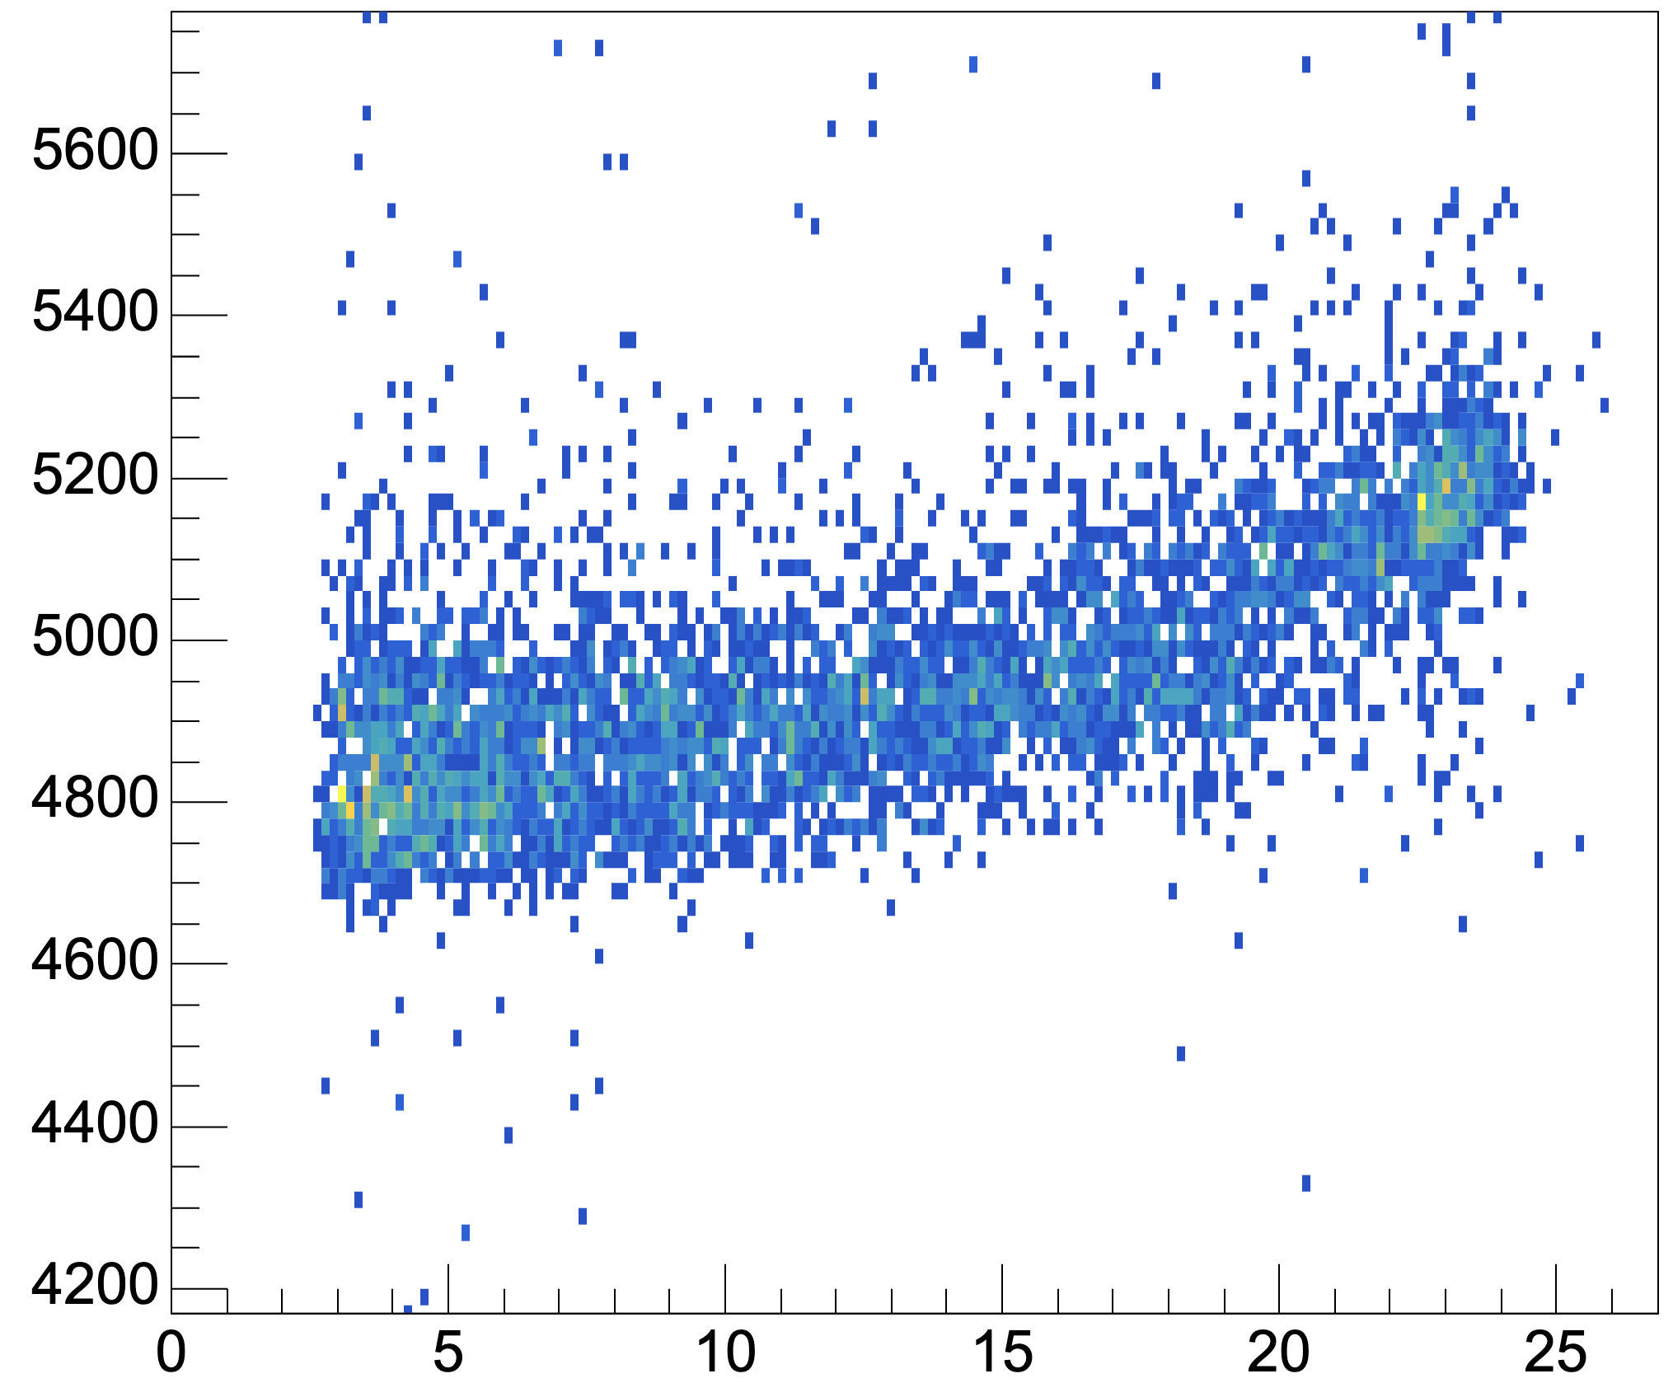
Drift Time effect on Vertical Position Calculation
Prop time (ns)
Prop time (ns)
Drift time (ns)
Radius (mm)
Mapping to Prop time dependance on drift radius
Vertical Position Calculation Analysis meeting 7/12/23

Slide 19
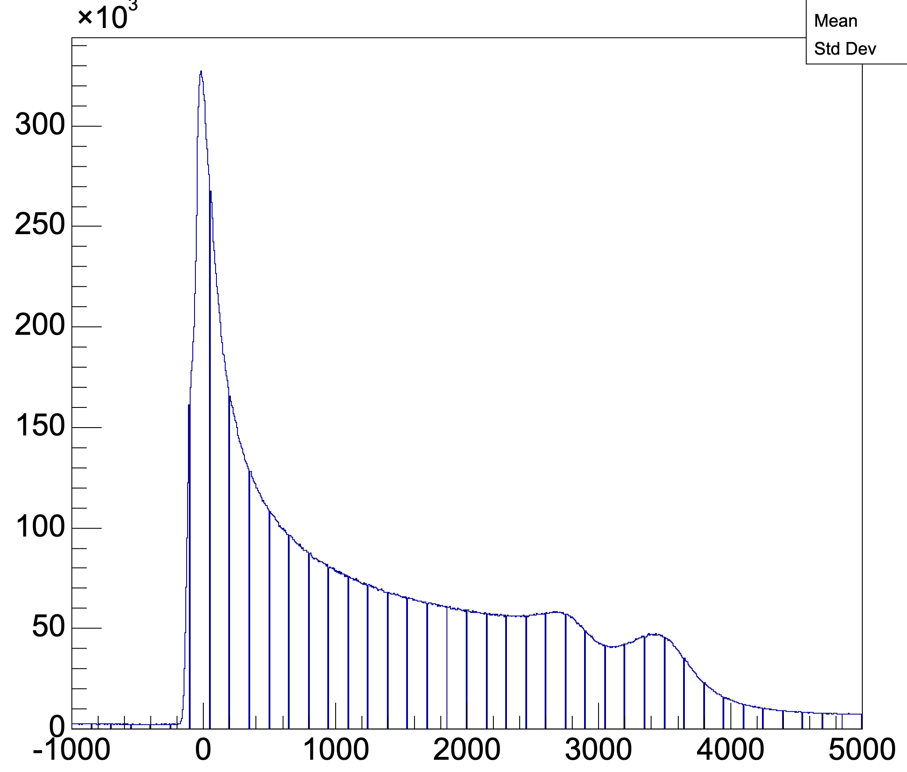
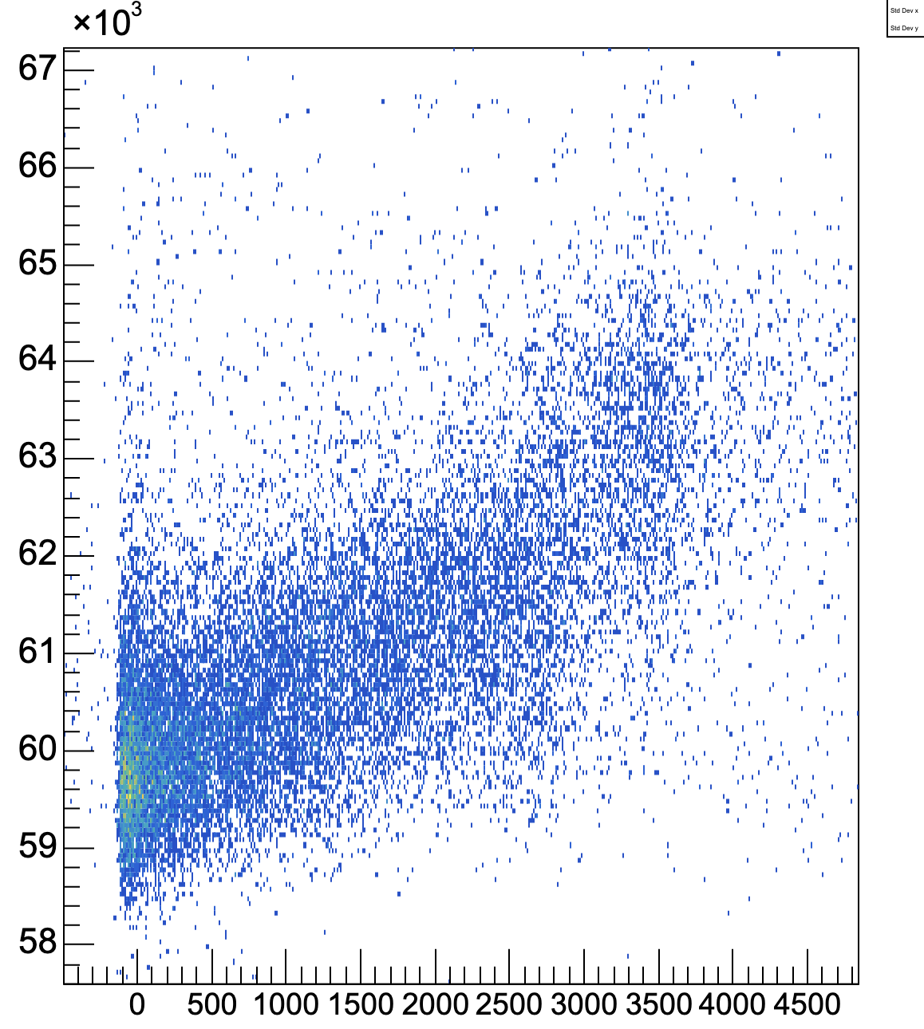
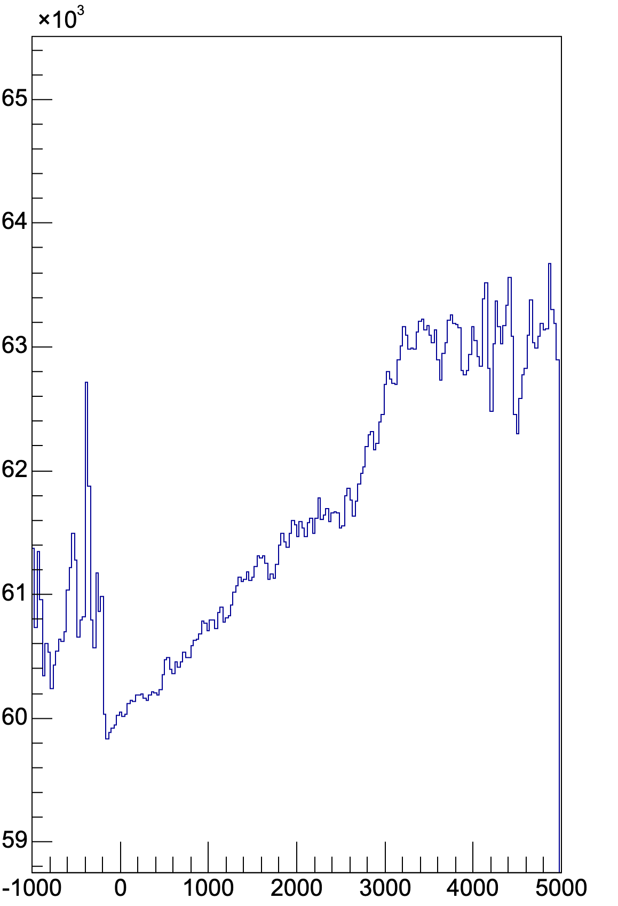
Correct for Drift time effect/Understand how it affects z to z’ mapping
Non-linear region
Noise/lowcount
Non-linear region
Linear region
Linear region
Flat/low count
No events for each drift time
Heatmap prop vs drift
Average prop vs drift
Non-linear region caused by avalanche forming by ground wire?
Vertical Position Calculation Analysis meeting 7/12/23

Slide 20
What makes the propagation time increase?
Large no. UV generated = plasma starts
1
threshold
t0
2
time
1- first ionization occurs in cell
2- anode fully quenched- avalanche has reached the cell
How can we explain this shift?
When does the plasma start to move?
Does the plasma start moving at time 1 or 2 or inbetween?
A mismatch between the time the plasma starts to move and our t0 causes this shift
Vertical Position Calculation Analysis meeting 7/12/23

Slide 21
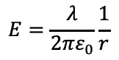
When does the plasma start?
1 Plasma starts moving on first ionization:
Assumes don’t need high E field around anode wire to start vertical motion
Anode wire
2 Plasma starts moving when anode quenched:
Assumes high E field needed to produce enough UV’s so that plasma/ionizations can move longitudinally without being stopped by ethanol/quenching gas
Anode wire
$$E=\frac{λ}{2πε_{0}}\frac{1}{r}$$
3 Combination of the two:
The plasma moves longitudinally slowly at the start then reaches the wire and moves at full speed
Slow speed at first as less UV emitted in low E region away from anode
Anode wire
Vertical Position Calculation Analysis meeting 7/12/23

Slide 22

Scenario $3$
Small r = sudden avalanche in high E field region, anode quenched quickly
Large r = more gradual accumulation of charge as avalanche forms over time in lower E field region
Same vertical position different drift radius
Avalanche
triggered
Vertical Position Calculation Analysis meeting 7/12/23

Slide 23
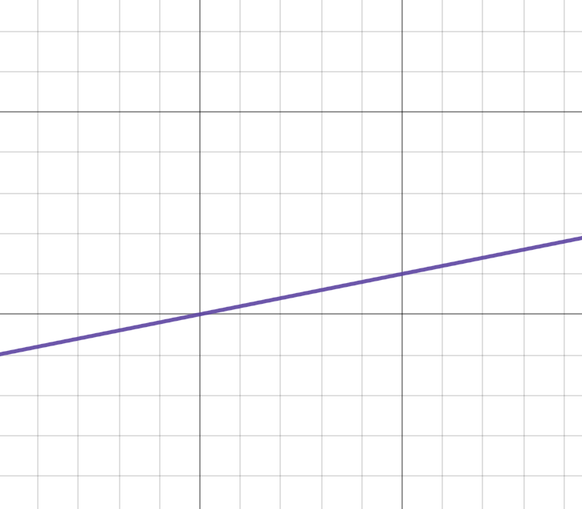

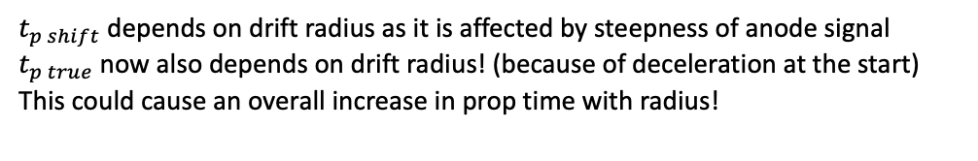
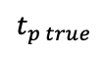
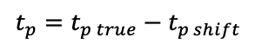
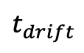
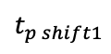
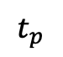
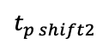
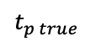
Scenario $3$
Large no. UV generated = plasma starts
Small r = sudden avalanche in high E field region, anode quenched quickly
Large r = more gradual accumulation of charge as avalanche forms over time in lower E field region
$$t_{p true}$$
Same vertical position different drift radius
$$t_{p shift1}$$
$$t_{p true}$$
$$t_{p shift2}$$
Avalanche
triggered
t2 measured
Prop time we use currently:
$${t_{p}=t}_{p true}−t_{p shift}$$
$$t_{p}$$
$t_{p shift}$ depends on drift radius as it is affected by steepness of anode signal $t_{p true}$ now also depends on drift radius! (because of deceleration at the start)
This could cause an overall increase in prop time with radius!
$$t_{drift}$$
Vertical Position Calculation Analysis meeting 7/12/23

Slide 24
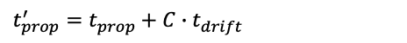
What makes the propagation time increase?
Plasma accelerates
Plasma reaches constant speed
Takeaway from this: Plasma forms at 1 but moves slowly until it reaches the anode wire seems most likely scenario
1
threshold
t0
2
Use linear region to estimate offset
time
1- first ionization occurs in cell
2- anode fully quenched- avalanche has reached the cell
$t_{prop}^{′}=t_{prop}+C$ $∙t_{drift}$
Vertical Position Calculation Analysis meeting 7/12/23

Slide 25
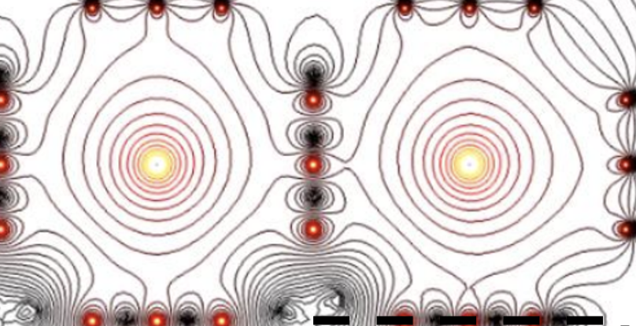
How do we correct for the time offset/slow speed?
Softwares could use
HEED++
Garfield
Geant4
Model full 3D plasma movement in comparable way to drift model
Use model to estimate the offset for different scenarios
Study affect of drift time with changing threshold (have contacted Manchester for tracker prototype data)
Vertical Position Calculation Analysis meeting 7/12/23

Slide 26
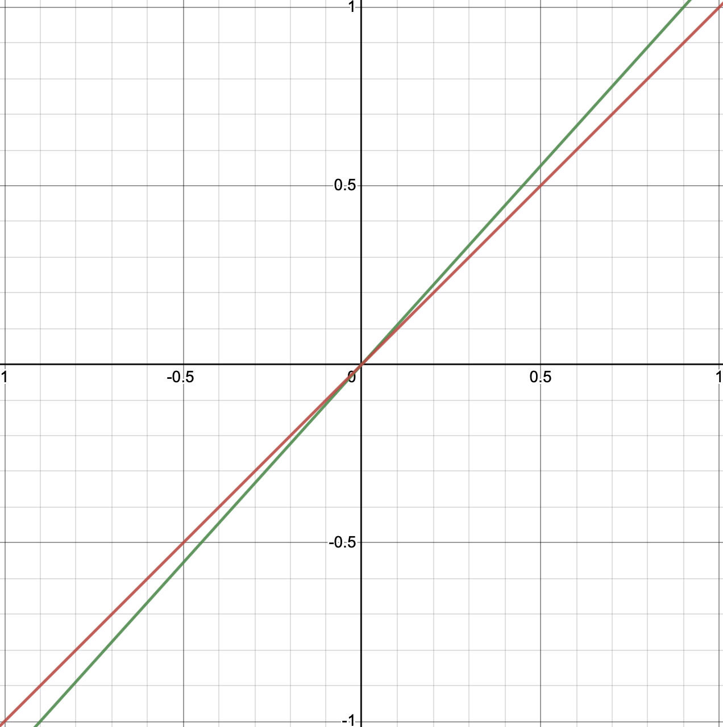
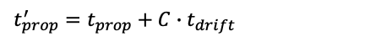
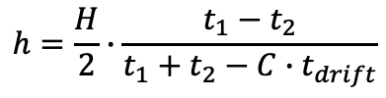
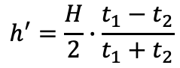
Correct for Drift time effect/Understand how it affects z to z’ mapping
First simple solution:
Assume anode timestamp value is before plasma starts to prop
Assume increase in prop time is caused by simple delayed start of plasma
Correct each timestamp by a small amount to account for the offset
Use linear region to estimate offset
Red:y=x
Green:corrected equation
$t_{prop}^{′}=t_{prop}+C$ $∙t_{drift}$
h’
$$h^{′}=\frac{H}{2}∙\frac{t_{1}−t_{2}}{t_{1}+t_{2}}$$
$$h=\frac{H}{2}∙\frac{t_{1}−t_{2}}{t_{1}+t_{2}−C∙t_{drift}}$$
Under these assumptions we are consistently underestimating our z values
Minimum on vertical position due to effect ~ 5% (effect we see is min error the unknown is probably larger)
h
Vertical Position Calculation Analysis meeting 7/12/23

Slide 27
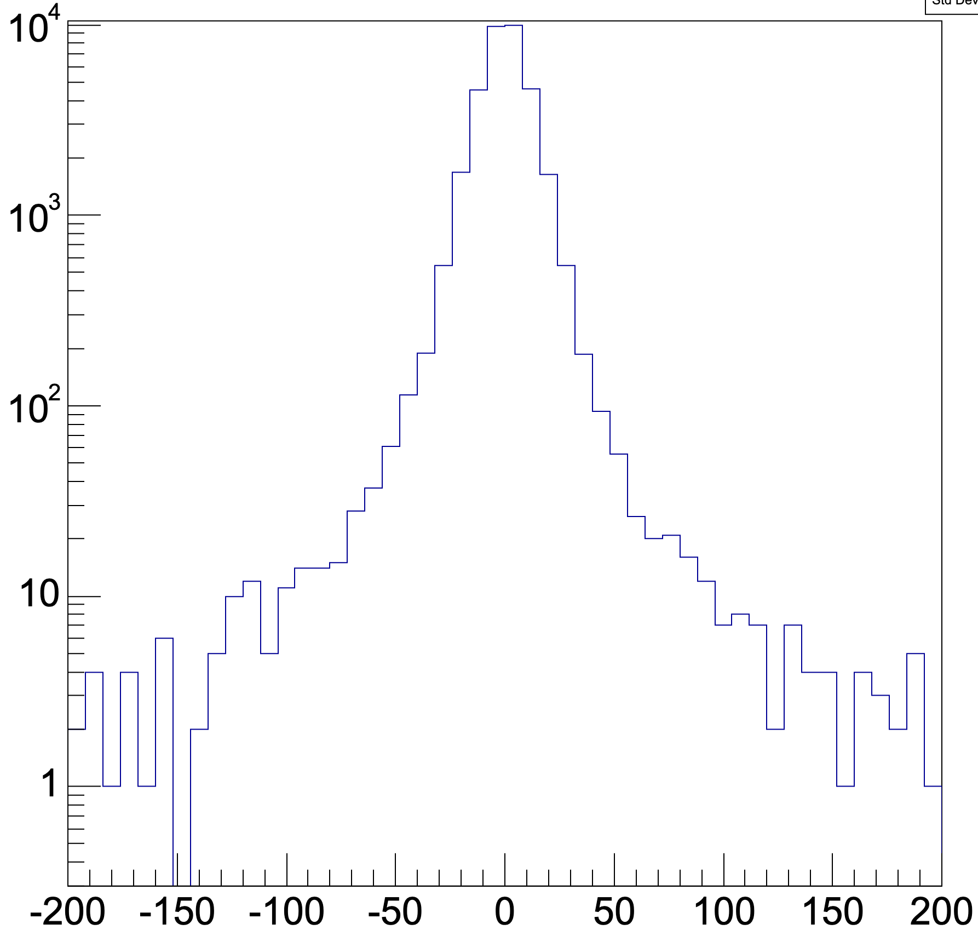
Other things working on
Tracker
δ₅
Using fitting code to test how different models affect our uncertainty
Making improved correction for vertical position effects
δ₂
δ₄
δ₃
δ₁
θ
Vertical Position Calculation Analysis meeting 7/12/23

Slide 28
Summary
There are multiple corrections we need to make to our h calculation
To do these need to model how plasma moves in 3D
Anode wire
Effect 1
Effect 2
Vertical Position Calculation Analysis meeting 7/12/23

Slide 29
EXTRA SLIDES
Vertical Position Calculation Analysis meeting 7/12/23

Slide 30

Manchester Prototype Data
Files:
Many data files – organization not clear
Key Files: .data files from Oscilloscope
.root files containing extracted waveform data
Files from a full run of the tracker – possible to recover tracks
Files from runs of individual cells
Different gas compositions were tested (Nitrogen, Helium, Full mixture)
Still unsure where ‘full data set’ is
Vertical Position Calculation Analysis meeting 7/12/23

Slide 31



Waveforms Extracted
(very hard to find …)
Anode signal
Derivative of anode signal
Full map of cells hit in a single event
Vertical Position Calculation Analysis meeting 7/12/23

Slide 32

3D Visualization code
Vertical Position Calculation Analysis meeting 7/12/23

Slide 33


Do we see same effects in these data?
Cell 1
Cell 1
Prop time
Prop time
Drift time
(we see same skewed gaussian as in SN data)
We need more data to see if the trend is accurate
Vertical Position Calculation Analysis meeting 7/12/23

Slide 34



Effect of threshold on propagation time
Threshold effect on prop time.
When does the plasma start moving vertically?
For the same height does this shape shift for different r’s?
Vertical Position Calculation Analysis meeting 7/12/23

Slide 35



261
812
Prop: 79.152
Drift: 1.872
Prop: 57.552
Drift: 0.3520
930
Prop: 64.52
Drift: 1.552

Slide 36



778
74
Prop: 82.382
Drift: 3.44
Prop: 64.208
Drift: 3.184
Anomalously small prop time for drift time
751
Prop:84.8
Drift: 1.28

Slide 37



576
416
Prop: 67.44
Drift: 0.512
Prop: 82.256
Drift: 0.815
287
Prop: 90.35
Drift: 1.04

Slide 38

0
Prop: 90.35
Drift: 1.04

Slide 39

Results with the new data set
We see the increase aswell
Look up all waveforms that form at the same height!!!
Look for them and how they change
Go back and work on deceleration model! – give estimate of this effect and
understanding of it
Show other stuff …
Test tomas’ fiting code on it!
Vertical Position Calculation Analysis meeting 7/12/23

Slide 40



Correcting vertical position
In practice this model returns the expected correction
$$h^{′}=\frac{H^{′}}{2}∙\frac{t_{1}−t_{2}}{t_{1}+t_{2}}$$
Linear velocity assumption:
$$h_{N3}^{′}=\frac{H′}{2}∙\frac{t_{5}−t_{6}}{t_{5}+t_{6}} − c_{N3}∙\frac{H^{′2}}{4}\frac{t_{5}−t_{6}}{t_{5}+t_{6}}\left(1−\left|\frac{t_{5}−t_{6}}{t_{5}+t_{6}}\right|\right)$$
NEMO-3 correction:
$$h_{SN}^{′}=\frac{H^{′}}{2}∙\frac{t_{1}−t_{2}}{t_{1}+t_{2}+c_{SN}\left(t_{1}^{2}+t_{2}^{2}\right)}+\frac{\frac{1}{2}(t_{1}−t_{2})}{\frac{2}{c_{SN}}+\frac{t_{1}^{2}+t_{2}^{2}}{t_{1}+t_{2}}}$$
New correction idea
(based off constant deceleration model)
$$c_{SN}=\frac{a}{u}$$
This being a good reconstruction method relies on a constant relationship between a and u
This must be investigated otherwise more error will be added
Other idea? – include drift time dependance??

Slide 41




Correcting vertical position
$$h_{SN}^{′}=\frac{H^{′}}{2}∙\frac{t_{1}−t_{2}}{t_{1}+t_{2}+c_{SN}\left(t_{1}^{2}+t_{2}^{2}\right)}+\frac{\frac{1}{2}(t_{1}−t_{2})}{\frac{2}{c_{SN}}+\frac{t_{1}^{2}+t_{2}^{2}}{t_{1}+t_{2}}}$$
New correction idea
(based off constant deceleration model)
$$c_{SN}=\frac{a}{u}$$
This being a good reconstruction method relies on a constant relationship between a and u
This must be investigated otherwise more error will be added
(model)
h
$$h_{SN}^{′}−h^{′}$$
(real data)
0.1
0.3
0.5
0.7
0.9
h’
h’
$$h^{′}$$
This new calculation provides the expected shift compared to the linear reconstruction and compensates for deceleration effects
But we need to be sure $c_{SN}$ is a useful/constant variable for cells - if it varies by event this isn’t a good choice of equation
Vertical Position Calculation Analysis meeting 9/11/23

Slide 42
Ways to test improved reconstruction models
Tracker
δ₅
Compare track height to calculated height
Width of this distribution indicates error on our vertical position
Width provides useful metric when testing new height formula
(also very useful when validating use of anode timestamps)
Other variables also affect distribution:
δ₂
δ₄
δ₃
δ₁
θ
-Angle of the hit
-Height of hit in cell
-Use of anode timestamps
-Distance of track from anode wire
(Using Tomas’ tracking software https://github.com/TomasKrizak/TKEvent)***
δ (mm)
Vertical Position Calculation Analysis meeting 9/11/23

Slide 43






Attempts to model data
Read Data
No events
$$t_{p}$$
Model Data
No events
Different assumptions:
No acceleration
Constant $\frac{a}{u}$
Randomly changing $\frac{a}{u}$
$$t_{p}$$
Vertical Position Calculation Analysis meeting 9/11/23

Slide 44


Angular Considerations
Prop time vs h plot with track angle cut applied
Rising effect still there
Entire distribution shifted up
Effect of multiple avalanche triggers with non-zero angle track
Propagation time (12.5us)
Prop time
h’
Angle of track
(Using Tomas’ tracking software https://github.com/TomasKrizak/TKEvent)***
Vertical Position Calculation Analysis meeting 9/11/23

Slide 45


Characteristic Times of Propagation
Drift time ~ ${10}^{−5}$sec
Propagation time ~ $\text{4} \text{x} {10}^{−5}$ sec
Partial Deadtime ~ 2 x ${10}^{−3}$sec
Full Deadtime ~$\text{4} \text{x} {10}^{−3}$ sec
Time to Quench ~
Characteriscic acceleration? – extract from previous plot
(to be completed …)
Vertical Position Calculation Analysis meeting 9/11/23

Slide 46



Edge Effects
~ upper and lower 10% cell
R6
R5
Drop in no. recorded events
Average propagation time spikes
Caused by multiple hits?/plasma decelerating so not reaching 2nd cathode?/…
Vertical Position Calculation Analysis meeting 9/11/23

Slide 47





Assume scenario $1$
Large no. UV generated = plasma starts
Small r = sudden avalanche in high E field region, anode quenched quickly
Large r = more gradual accumulation of charge as avalanche forms over time in lower E field region
$$t_{p true}$$
Same vertical position different drift radius
$$t_{p shift1}$$
$$t_{p true}$$
$$t_{p shift2}$$
Avalanche
triggered
t2 measured
Prop time we use currently:
$${t_{p}=t}_{p true}−t_{p shift}$$
$$t_{p}$$
$t_{p shift}$ depends on drift radius as it is affected by steepness of anode signal
We would expect tp to decrease with increasing rad - not what we see
$$t_{drift}$$
Vertical Position Calculation Analysis meeting 9/11/23

Slide 48






Assume scenario $2$
Large no. UV generated = plasma starts
Small r = sudden avalanche in high E field region, anode quenched quickly
Large r = more gradual accumulation of charge as avalanche forms over time in lower E field region
$$t_{p true}$$
Same vertical position different drift radius
$$t_{p shif11}$$
$$t_{p true}$$
$$t_{p shift2}$$
Avalanche
triggered
t2 measured
Prop time we use currently:
$${t_{p}=t}_{p true}+t_{p shift}$$
$$t_{p}$$
$t_{p shift}$ depends on drift radius as it is affected by steepness of anode signal
We would expect tp to increase with increasing rad – this is what we see!
$$t_{drift}$$
Vertical Position Calculation Analysis meeting 9/11/23

Slide 49


Effect of drift time
L
h
$$ε=\frac{H′}{2}∙\frac{t_{5}−t_{6}}{t_{5}+t_{6}}$$
$$d_{1}$$
$$d_{2}$$
But $t_{5}$ and $t_{6}$ measured from time after avalanche first reaches cathode
Correction of $t_{5}^{′}=$ $t_{5}$+ $t_{drift}$ and $t_{6}^{′}=$ $t_{6}$+ $t_{drift}$ needs to be made?
Need to make quick estimate this effect will have/ investigate if the effect can be seen in the data
Vertical Position Calculation Analysis meeting 9/11/23

Slide 50
How continue analysis
Extract deceleration parameters from this plot
Check effective length of tracker cell/develop method to check
Investigate effect of drift time?
Investigate how much these parameters change between cells
… and between runs*
Investigate effects when use replacement anode timestamps
Estimate error on vertical position due to plasma speed change/formulate new correction
Develop plasma model??
*(do we need to recalibrate corrections we will make for each run/for each cell)
Vertical Position Calculation Analysis meeting 9/11/23

Slide 51
Summary
L
h
$$d_{1}$$
$$d_{2}$$
Clearly the affect of plasma deceleration are noticeable
Corrections can be made to account for these/their uncertainty can be estimated
Continue analysis to understand these effects more and correct for them
Vertical Position Calculation Analysis meeting 9/11/23

Slide 52
When does the plasma start?
1 Plasma starts moving on first ionization:
Assumes don’t need high E field around anode wire to start vertical motion
Anode wire
2 Plasma starts moving when anode quenched:
Assumes high E field needed to produce enough UV’s so that plasma/ionizations can move longitudinally without being stopped by ethanol/quenching gas
Reasons prefer 2 over 1:
Anode wire
$$E=\frac{λ}{2πε_{0}}\frac{1}{r}$$
3 Combination of the two:
UV’s can’t move longitudinally between cells easily (quenching gas/if they did tracker wouldn’t work)
Implies same limited motion of UV’s in vertical position
Suggests high E field environment of anode is needed to generate enough UV to sustain avalanche
Depending on radius of high enough E field region we can get scenario 3
The plasma moves longitudinally slowly at the start then reaches the wire and moves at full speed
Slow speed at first as less UV emitted in low E region away from anode
Anode wire
Vertical Position Calculation Analysis meeting 9/11/23

Slide 53
Plasma Model
Yorks code: https://github.com/SuperNEMO-DBD/SNDrift
MAGBOLTZ and other software used to model electric field and model drift time from this
Use info gathered here to develop vertical movement model aswell?

Slide 54





Prop time distribution
1D slice from the distribution
$$P\left(t_{p}\right)$$
No events
$$t_{p}$$
$$t_{p}$$
How describe the shape? – (appears as a RH skewed Gaussian)
Assume initial velocities drawn from gaussian distribution – (physically motivated)
Initially assuming constant velocity:
Skew of $t_{p}$ distribution explained as projection of gaussian velocity distribution
How would acceleration appear on this distribution?
$$P\left(u\right)=\frac{1}{σ\sqrt{2π}}e^{−\frac{1}{2}{\left(\frac{\left(u−μ\right)}{σ}\right)}^{2}}$$
$$P\left(t_{p}\right)=\frac{1}{σ\sqrt{2π}}e^{−\frac{1}{2}{\left(\frac{\left(\frac{H^{′}}{t_{p}}−μ\right)}{σ}\right)}^{2}}$$
$$u=\frac{H^{′}}{t_{p}}$$
Vertical Position Calculation Analysis meeting 9/11/23

Slide 55
















Can linear deceleration model describe this distribution?
$$P\left(t_{p}\right)=\frac{1}{σ\sqrt{2π}}e^{−\frac{1}{2}{\left(\frac{\left(\frac{H^{′}}{t_{p}}−μ\right)}{σ}\right)}^{2}}$$
Constant Velocity Model:
$$u=\frac{H^{′}}{t_{p}}$$
(red)
$$P\left(t_{p}\right)$$
Linear Deceleration Model (used previously to describe average distribution)
$$u=\frac{H^{′}}{t_{p}}+\frac{a}{2t_{p}}∙\left(t_{1}^{2}+t_{2}^{2}\right)$$
$$P\left(t_{p}\right)=\frac{1}{σ\sqrt{2π}}e^{−\frac{1}{2}{\left(\frac{\left(\frac{H^{′}+k(d)}{t_{p}}−μ\right)}{σ}\right)}^{2}}$$
(green)
$$u=\frac{H^{′}}{t_{p}}+\frac{a}{2t_{p}}∙func(d,u,a)$$
$$t_{p}$$
Effect of k is to shift $t_{p}$ upwards and increase its width/skew
If acceleration is zero k=0
Change in k parameter across z position implies plasma deceleration
Can extract metric of acceleration from change in k over d
Analogous to extracting acceleration from change in average prop time (but more rigorous)
Can now see the average prop time changes with d because of change in skew of ‘gaussian’ $P\left(t_{p}\right)$
$$u=\frac{H^{′}+k(d,\frac{a}{u^{2}})}{t_{p}}$$
$$k\left(a=0\right)=0$$
(expressing u in terms of k(u), may seem strange
but given, $k\left(a=0\right)=0$, seeing effects of non-zero
k can still be informative)***
$$t_{p}$$
$${<t}_{p}>$$
$$z^{′}$$
$$z^{′}$$
Vertical Position Calculation Analysis meeting 9/11/23

Slide 56



Can linear deceleration model describe this distribution?
K(d,a/u^2)
$$z^{′}$$
100 tp distributions at different $z^{′}$ values were simultaneously fitted to find the shared parameters $\left(μ,σ\right)$ and the distance dependent parameter $\left(k\right)$
We can see how the distribution of propagation times becomes wider and shifts upwards for large and small z (due to acceleration)
We can test the linear deceleration model by fitting this graph
Can extract key metrics for the cell to correct for vertical position
Vertical Position Calculation Analysis meeting 9/11/23

Slide 57


Can linear deceleration model describe this distribution?
LH side of hist/peak not consistent with long tale for linear deceleration
Amount of skew cant be explained by linear deceleration
Other effects causing changing speed:
Cell recently active (already taken into account)
Drift time dependance?
(model data with width matched to SD of peak-tale very small – approx a gaussian distribution)
Vertical Position Calculation Analysis meeting 9/11/23

Slide 58
V≠constant ?
There are many scenarios where the plasma propagation time of a cell changes
If the cell (or a neighbour) was recently active the local electric field decreases
Results in longer propagation times
Propagation time (12.5us)
Time since cell last fully active* (12.5us)
*fully active = last event resulted in valid R5 and R6 timestamp measurements ie. Standard/expected cell behaviour
Vertical Position Calculation Analysis meeting 9/11/23

Slide 59


Drift time cut
With drift time cut
Without drift time cut
(typical example – come up with metric to describe this)
A lot of the skew is accounted for by drift time
Vertical Position Calculation Analysis meeting 9/11/23

Slide 60

Uncertainty Considerations - continued
Tracker
Can verify uncertainty of ppt or height estimate via track fitting
Use this as regular check in analysis or only verification of method??
Certain variables also affect resolution:
δ₅
δ₂
δ₄
δ₃
δ₁
Distribution we expect to see
Angle of the hit
Height of hit in cell
θ
Use of anode timestamps
Distance of track from anode wire
e-
δ (cm)

Slide 61

Other ways to spot deceleration effects
R6
R5
(plot shows the average R6 value for each R5 value)
** units are different on plots- will scale axis before presentation

Slide 62






Slow deceleration model
L
Assume the plasma is undergoing a small constant deceleration
$$d_{1}$$
$$d_{2}$$
$$Vel=V+at$$
$$t=\frac{d}{V}+\frac{2ad^{2}}{V^{3}}$$
Small deceleration approximation
Express $ε$ and plasma prop time in terms of true distance
$$ε(d_{1})=\frac{L}{2}∙\frac{\left(2d_{1}−L\right)∙V^{2}. +2a(d_{1}^{2}−(L−d_{1}^{})^{2})}{L∙V^{2} +2a∙(d_{1}^{2}+(L−d_{1}^{})^{2})}$$
Higher order correction
Higher order correction
$$t_{p}\left(d_{1}\right)= \frac{L}{V} +\frac{2a}{V^{3}}(d_{1}^{2}+(L−d_{1}^{})^{2})$$

Slide 63



Characterize Plasma Movement
Assume plasma speed constant in small time region
$$t=\frac{d}{v}$$
R6 ~ measure of distance half plasma travelled
R6
Data fitted with …
2nd order equation to fit t1 to t2
R5
Note in this fit k doesn’t equal v even though they should
Be the same – suggests model is not a good description?

Slide 64
Main aim of analysis: assess added error to vertical height calc by assuming constant plasma propagation speed

Slide 65
What is the plasma/theory of how think it moves:
Different models of how the plasma moves:
Slow decelerating model
Sudden change in speed model
Other??

Slide 66








Plasma theory
L
h
Define a quantity $ε$
$$d_{1}$$
$$d_{2}$$
$$ε=\frac{L}{2}∙\frac{t_{1}−t_{2}}{t_{1}+t_{2}}$$
Plasma takes $t_{1}$ to travel this distance
Plasma takes $t_{2}$ to travel this distance
Define the time it takes for both sides of the plasma to reach both cathode ends
$$t_{p}=t_{1}+t_{2}$$
If the plasma propagates at constant speed:
$$t_{1}=\frac{d_{1}}{V}$$
$$t_{2}=\frac{d_{2}}{V}$$
$$ε=\frac{L}{2}∙\frac{d_{1}−d_{2}}{d_{1}+d_{2}}$$
ie. h$=ε$
Hence this equation gives us the height of the hit assuming constant plasma propagation speed
Our aim is to test this assumption/estimate added error due to changing plasma speed

Slide 67
Angular Considerations
Prop time vs h plot with track angle cut applied
Rising effect still there
Entire distribution shifted up
Effect of multiple avalanche triggers with non-zero angle track
Propagation time (12.5us)
**need to confirm this huge shift in other data
h’
(Using Tomas’ tracking software https://github.com/TomasKrizak/TKEvent)***
Vertical Position Calculation Analysis meeting 9/11/23

Slide 68
Code that checks position of optical module – confirms drift time – make few slides about this and work you did on it!!

Slide 69
Motivations for models

Slide 70




Sudden change model
L
$$d_{1}$$
$$d_{2}$$
Assume plasma speed changes after nearest cathode is reached
Equivalent to having two sides of plasma propagating at different average speeds
K = $\frac{speed of LH plasma}{speed of RH plasma }$
V = speed of LH plasma
$$ε(d_{1})=\frac{L}{2}∙\frac{d_{1}\left(k+1\right)−L}{d_{1}\left(k−1\right)+L}$$
Note: both return to original equations if we set k=1
Both given as functions of $d_{1}$ (ie. true position of the hit)
$t_{p}(d_{1})=\frac{1}{V}∙(d_{1}\left(1−\frac{1}{k}\right)+\frac{L}{k}$)

Slide 71





$ε$ has mapping to true distance measurement
Can plot this with real data
Propagation time against true distance in these models
Projecting the d1 to eps conversion onto the bot LH plot gives a $t_{p}$ vs eps plot (this can be plotted from real data)
Discontinuities in eps values is built in by the ‘instant speed change’ – nonphysical but general trends can agree with observation

Slide 72



Slow deceleration model
L
Assume the plasma is undergoing a small constant deceleration
$$d_{1}$$
$$d_{2}$$
$$t=\frac{d}{V}+\frac{2ad^{2}}{V^{3}}$$
Small deceleration approximation
$$ε(d_{1})=\frac{L}{2}∙\frac{\left(2d_{1}−L\right)∙V^{2}. +2a(d_{1}^{2}−(L−d_{1}^{2})^{2})}{L∙V^{2} +2a∙(d_{1}^{2}+(L−d_{1}^{2})^{2})}$$
Higher order correction
Higher order correction
$$t_{p}\left(d_{1}\right)= \frac{L}{V} +\frac{2a}{V^{3}}(d_{1}^{2}+(L−d_{1}^{2})^{2})$$

Slide 73

$ε$ has mapping to true distance measurement
Can plot this with real data
Propagation time against true distance in these models
Gap in these metrics why?
Why does this decelerating model give more values for epsilon? – how does changing a or the other relations affect this??

Slide 74








Delayed deceleration model
L
Assume the plasma undergoes a small constant deceleration after a set time
$$d_{1}$$
$$d_{2}$$
$$d=Vt$$
$$d=Vt−\frac{a{(t−t_{c})}^{2}}{2}$$
$$\frac{d}{V}$$
Equivalent transformations on small acceleration approximation
$$t=$$
$$\frac{d}{V}+\frac{2a{(d−d_{c})}^{2}}{V^{3}}$$
Plug t equation into $t_{p}$ and $ε$ equations:
$$ε=\frac{L}{2}∙\frac{t_{1}−t_{2}}{t_{1}+t_{2}}$$
$$t_{p}=t_{1}+t_{2}$$

Slide 75



Other models
Can plot this with real data
Maybe a further model of slow gradual deceleration then faster deceleration could explain the full picture

Slide 76




Slow deceleration model
H
Assume the plasma is undergoing a small constant deceleration
$$d_{1}$$
$$d_{2}$$
$$Vel=V+at$$
Express $ε$ and plasma prop time in terms of true distance
$$h^{′}(h)=\frac{H′}{2}∙\frac{\left(2h−H′\right)∙V^{2}. +2a(h_{}^{2}−(H′−h_{}^{})^{2})}{H′∙V^{2} +2a∙(h_{}^{2}+(H′−h_{}^{})^{2})}$$
Higher order correction
Higher order correction
$$t_{p}\left(h\right)= \frac{H′}{V} +\frac{2a}{V^{3}}(h_{}^{2}+(H′−h)^{2})$$
Vertical Position Calculation Analysis meeting 9/11/23

Slide 77
Other models:
Combing elements of all previous models
Eg. A period of small deceleration then larger deceleration after a set time
Models show how characteristics of graphs correspond to plasma motion

Slide 78
Key results of plasma non-linearity:

Slide 79

1051
1051 – an indiviaual cell
Note the general rise aswell as the sharp rise at the edges

Slide 80


902
840

Slide 81


1051
1051
From this we get the deadtime of the cell – how does this value compare to the plasma propagation time?

Slide 82


Are these events occurring more in one position of cells than the other – do an epsilon cut

Slide 83


Maybe there is another explanation for these trends?
Lack of resolution for certain hits in these regions?
ie. We don’t get longer prop times in general just the drop off of the short ones
Why does this drop off occur? Plasma decelerates so never reachs ends? – but then surely would expect rise in the longest plasma propagation times at the same time??
Further selection procedures on plots on previous slides may be able to show this more??
902
The 2nd ary curve drops off but the primary doesn’t at high and low epsilon – why is this???
Its not that the top raises its that the bottom drops off – why does this happen??? – understanding this effect is key to understanding the way the plasma propagates. – can we model / reproduce this effect ? – maybe because theres a hard limit on the max propagation time!
1051

Slide 84

Prop time
H’ value

Slide 85



Proptime vs deadtime investigation
Frist R5 R6
Check against how drift time changes
Proptime_previous – prop_time
Second R5 R6
Difference in propagation time between the first and last hits
How can there be such a big difference in propagation when the deadtime is so much smaller than the propagation time – maybe including drifttime into considerations is the key here – perhaps start moving before t0 recorded ie. Plasma starts propgating before reach anode – are any of these linked with the drift time???

Slide 86


902 run
$t_{p1}$- $t_{p2}$ (10-4 sec)
Time since cell last active (10-7 sec)

Slide 87


Z vs deadtime
No apparent correlation with z or between z’s of the two successive hits and the deadtime
Z-Z_previous
z

Slide 88

End of Presentation Slides

Slide 89




V≠constant ?
$t_{p}$ is longer if cell recently active
$t_{p}$ reaches steady value
(10-7 sec)
$$ε$$
Plasma propagation time dependent on how recently cell was last active. Plasma slowed?
$t_{p}$ changes with $ε\left(\sim h\right)$This also suggests changing plasma speed

Slide 90
Slowly decelerating plasma
Delayed plasma deceleration
Plots show trends we’d expect in different scenarios of plasma changing speed

Slide 91

V≠constant ?
Check against how drift time changes
How can the difference be this big?

Slide 92



Correct for Drift time effect/Understand how it affects z to z’ mapping
The plasma propagates very close to the anode due to the strong electric field there- much more likely a photon is emitted in this region – inclines more avalanches to form here …
$$E=\frac{λ}{2πε_{0}}\frac{1}{r}$$
There is an offset between the timing of anode signal and the start of plasma moving- this offset gets bigger for larger drift times – estimate offset to be 1ms
Anode signal triggers
High no. UV $γ$’s emitted soon after/before
Avalanche Propagates to anode
Anode signal triggers
High no. UV $γ$’s emitted some time after
We see the effect of a delay in plasma speed if larger r
Means anode signal does not mark start of plasma propagating at normal speed – indicates some time before
Vertical Position Calculation Analysis meeting 9/11/23

